Slide 1
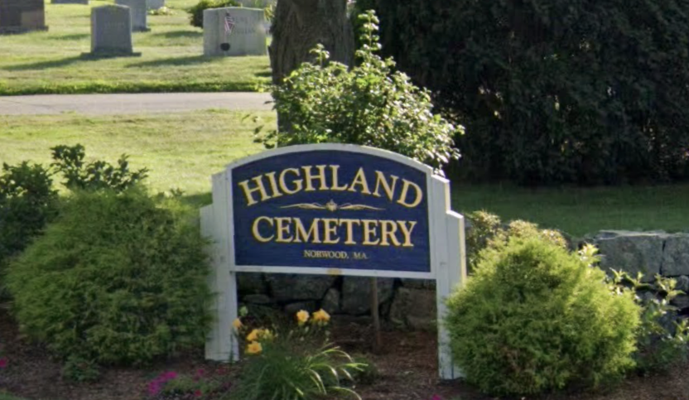
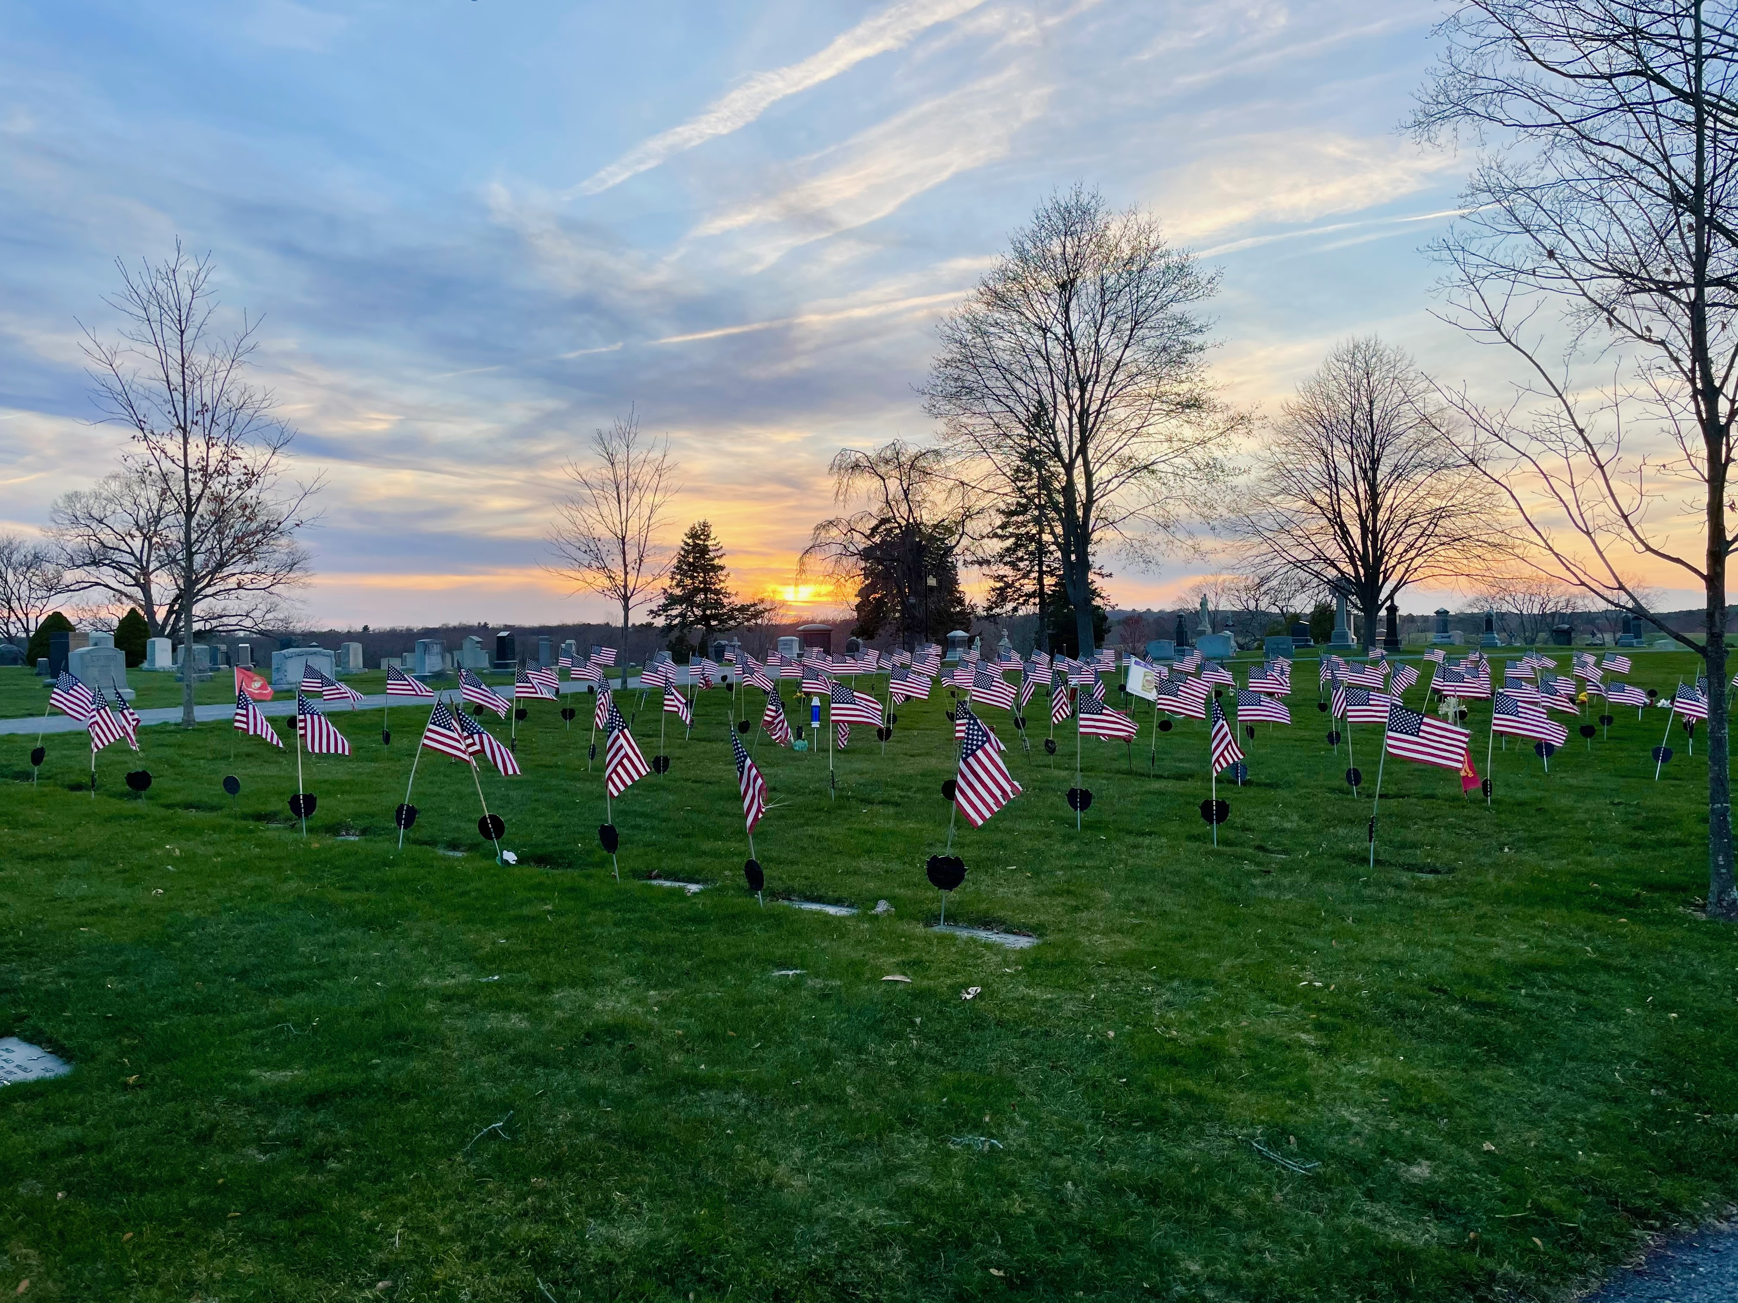
Highland Cemetery Norwood, Massachusetts

Slide 2
Highland Cemetery Introduction & History
A Cemetery Committee was formed in March of 1879 and made their first report in the Annual Report for the year ending January 31, 1880.
The Committee, which consisted of George Everett, Lewis Day, William Curtis Fisher, Ellis Draper, and Francis O. Winslow, was authorized to lay out a newly-purchased tract of land for a cemetery. The tract consisted of 17 and 2/10 acres conveyed to the town by Matthew Clay, John Nugent, William Cuff, and others. [In 1881, an additional 29 acres was purchased by the town for cemetery use. Additional land was acquired in 1902, 1955, and 1967.]
The Committee chose the name “Highland View Cemetery” and then engaged Mr. Reuben T. Woodward (1826-1911) to lay out a plan for 1/3 of the land. Woodward (1826-1911) was an experienced landscape gardener and horticulturalist. Born in Boston, he learned gardening beginning at the age of 7 when he was “bound out” to a retired sea captain in Jamaica Plain. At 14 he worked for his brother-in-law who was in charge of landscapes for several estates in Brookline. Beginning in 1853 he operated his own landscape gardening business in South Reading, Melrose, and, later, Haverhill. When the Civil War, began he enlisted in the army and was part of the 21st Regiment, Massachusetts Infantry. Injured at New Bern, NC, he was honorably discharged and returned to his occupation. In addition to the Boston area, for a time he was assistant superintendent of Golden Gate Park in LA and worked in Oakland and Pasadena, CA before his eventual return to Boston. R. T. Woodward designed and implemented the initial “Plan of Highland View Cemetery” in Norwood. He was paid nearly $2,000 for his services which included labor, men, and teams to create the cemetery landscape out of the then undeveloped land.
By September, 1879, most of the “important” avenues were completed and 200 “desirable” lots were offered for sale. Prices for lots would range from 10-40 dollars, according to location. The charge for opening a grave was set at $5; if it was for a child under 10, $3.
The report “declared that all citizen residents within the Town or who have at any time resided in the Town, shall be entitled to bury their dead therein,” as long as they followed the rules and regulations. A few stand out. No lot shall be enclosed by a wall, fence, coping, hedge or anything else; granite posts with tops no higher than 1 inch above ground would mark corners of lots. And Dogs will not be admitted into the Cemetery, nor any person carrying a firearm.
By the Annual Report for the year ending January 31, 1884, the commissioners commented that people were waiting until a death before purchasing a lot. Perhaps because of this prompt, in the following year’s report, the commissioners, now Francis O. Winslow, Albert G. Webb, and W. Allen Talbot, noted that a good number of lots had been sold. These included lots purchased by the Morrill, Shattuck, and Winslow families (all familiar names).

Slide 3
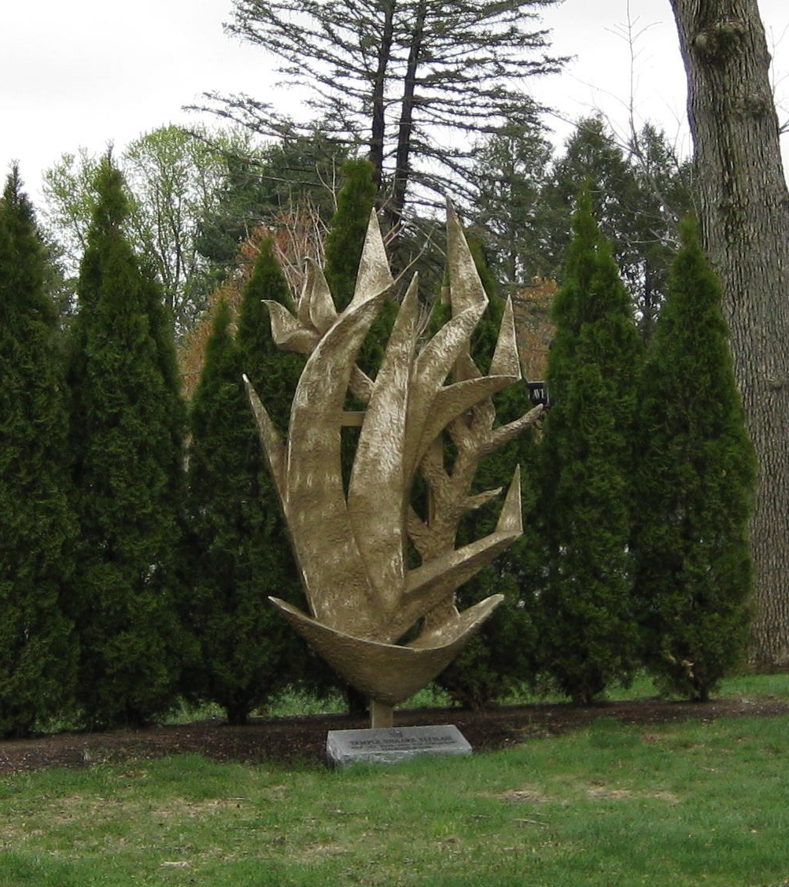
Monuments and Memorials
Jewish Memorial
The Burning Bush adorned the Temple Shaare Tefilah’s front exterior at 556 Nichols Street from 1966, when the congregation moved there from Washington Street, until 2009, when the Nichols Street building was sold to the Jain Center and the congregation moved to Commerce Way. In 2017 when the congregation dissolved, the Temple approached the Board of Selectmen about donating the Burning Bush sculpture to the town. The Selectmen unanimously approved acceptance of the donation and it was placed within the Jewish section of Highland Cemetery.

Slide 4
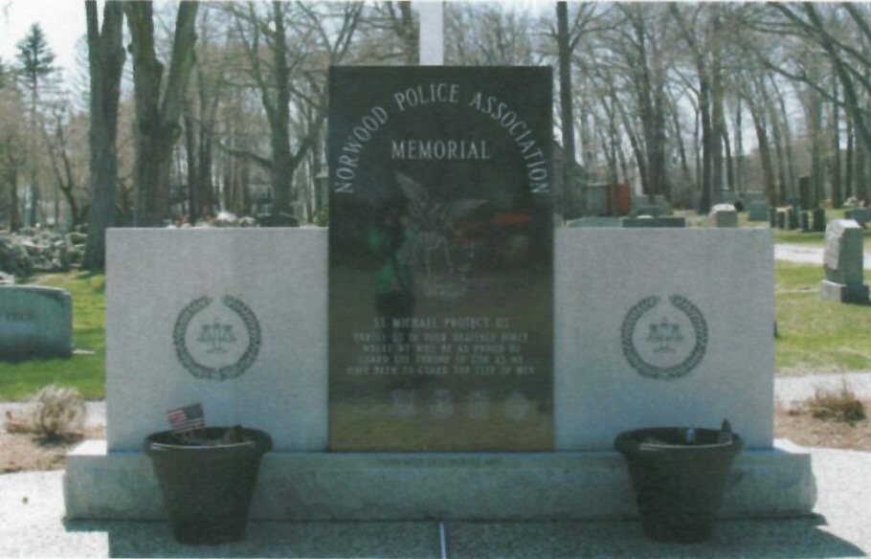
Monuments and Memorials
Norwood Police Association
This memorial honors the departed members of the Norwood Police Association was unveiled in 1995.

Slide 5
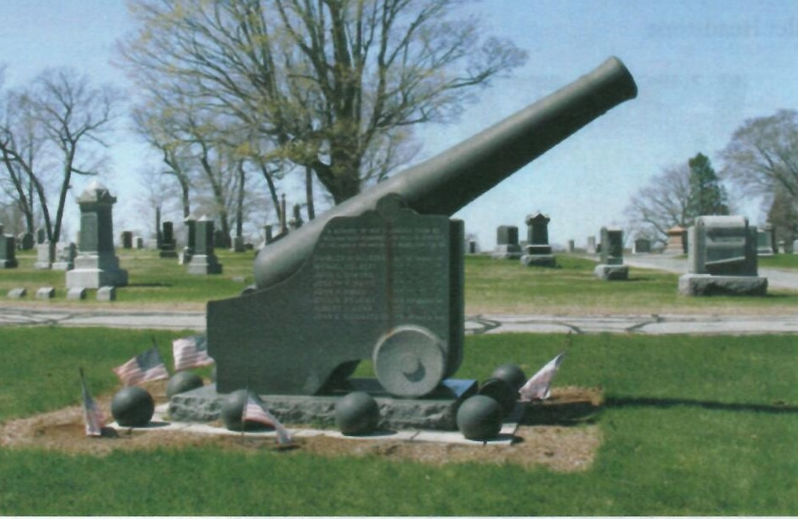
Monuments and Memorials
Civil War cannon and planter
The Civil War cannon was dedicated by the George K. Bird Grand Army of the Republic Post 169 in memory of South Dedham comrades who lost their lives in the War of the Rebellion. A memorial to the Unknown Dead of that same conflict, erected in 1905 by the G.A.R. Women’s Relief Corps, stands nearby.

Slide 6
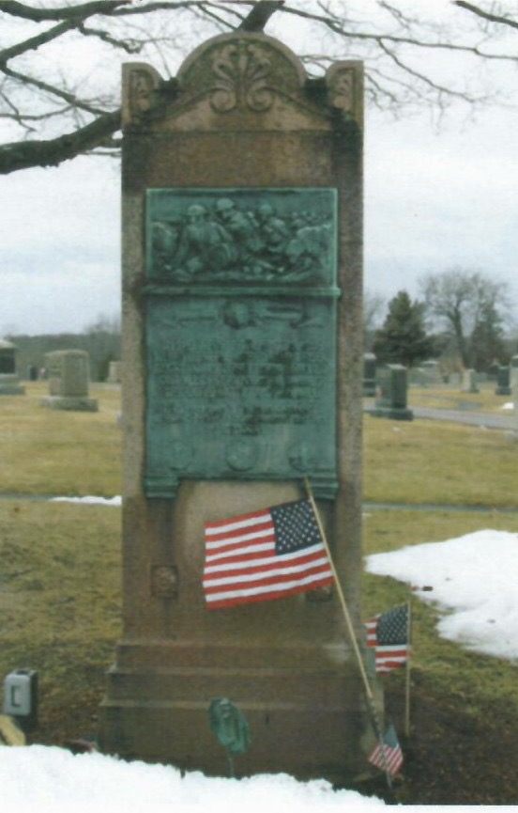
Monuments and Memorials
World War I Memorial
A bronze relief tribute to World War I veterans stands near the Civil War memorial. It was dedicated in 1921 by the American Legion Norwood Post No. 70 “in memory of their comrades who in the world war, on land and sea, fought valiantly, suffered, endured, gave all in service and gained through death, immortal life.” Designed by Berthe Dolores Dion, a young Boston sculptor who attended the Massachusetts Normal Art School. It consists of a bronze tablet set in Braintree red granite. The bronze tablet was cast by T. F. McGann & sons of Boston.
The nearby Veterans section was set aside in 1973.

Slide 7
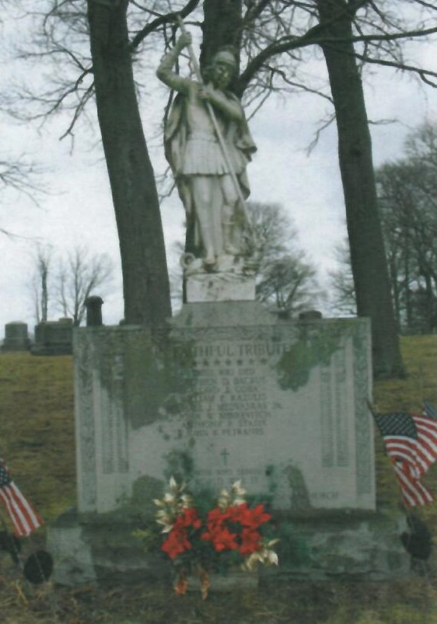
Monuments and Memorials
St. George World War II Memorial
The memorial to Lithuanian veterans of World War II was transported from the parish property of St. George Catholic Church in South Norwood when that church was closed by the archdiocese. Originally erected in 1949, the monument consists of a foundation and pedestal of Westerly, Rhode Island granite topped by a striking marble statue of St. George commemorating the 152 members of the parish who served, and the seven parishioners who gave their lives, “for God and Country.”
It stands today at the crest of the hill, behind Columbia Walk and Gov. Allen’s gravestone.

Slide 8
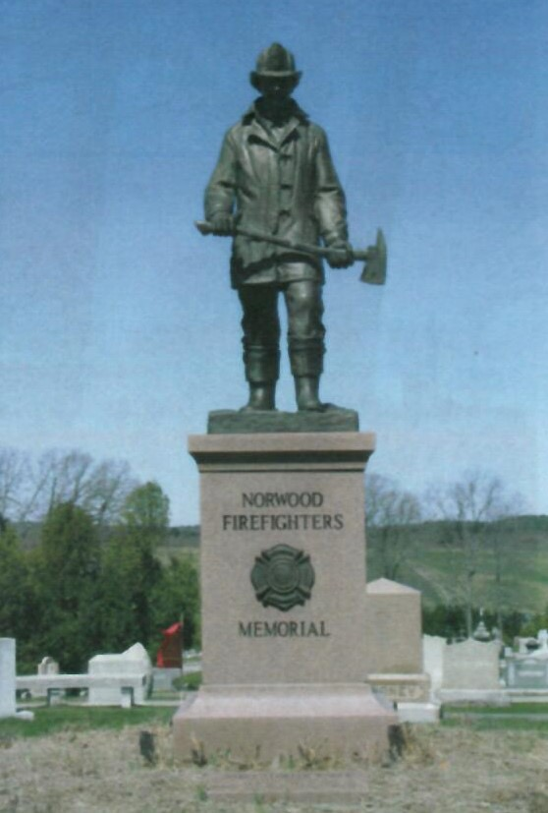
Monuments and Memorials
Firefighters Memorial
“Big Jake,” the Norwood Firefighters Memorial statue, friendship walk, and meditative benches were erected in 2001 and honors Norwood’s firefighters of the past, present, and future.

Slide 9
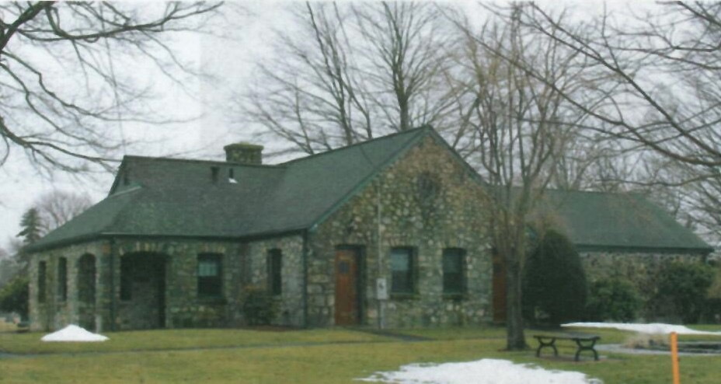
Administration Building
Administration Building
The administration building was erected during the Depression. In 1934, the project for an Administration Building was approved by the federal Emergency Relief Administration. It was completed the following year with funds from the ERA, and a town appropriation. It was designed by local architect John Bamber. It was built with a concrete foundation and floor and a fieldstone exterior. It contains office space, storage space, and public restrooms (which were recently refurbished by the town). It is complemented by wood doors with ornate brass hardware.

Slide 10
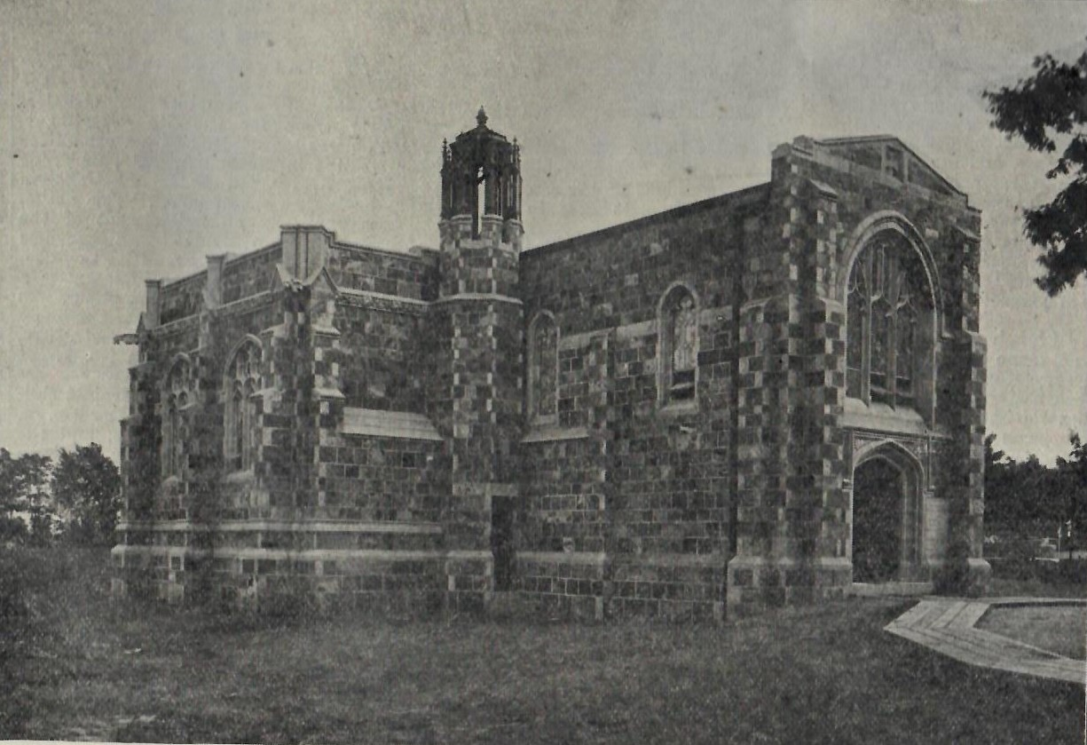
Chapel of St. Gabriel the Archangel
In 1903, Lewis and Anna Smith Day, along with their son, Fred Holland Day, oversaw the construction of the Chapel of St. Gabriel the Archangel in Norwood’s Highland Cemetery. Designed by the architectural firm of Cram, Goodhue, and Ferguson, two members of which, Ralph Adams Cram and Bertram Grosvenor Goodhue, were close friends of Fred Holland Day’s, the neo-Gothic chapel’s elegance depends on its simple proportions rather than a richness of decoration. Materials included a seam faced granite and limestone exterior and white marble interior trim. The building contains the chapel itself as well as a chantry where tombs for the family were placed. On May 30, 1903, the chapel was officially dedicated to the memory of Joseph and Hannah Rhoades Day and Lyman and Melinda Guild Smith with the moving words, “They were among those who comprised the small family of the early town of South Dedham, who were interested in its prosperity and its moral welfare. Here they lived and labored and died and we have entered into their labors.” The solid doors of the chapel were constructed from wood salvaged from an 18th century Tiot farmhouse and barn. At the direction of the family, the chapel is available to all residents of the town, at no charge, for funeral services irrespective of religious beliefs. Along with the donation of the building, the Days made a special bequest to the town to help cover maintenance expenses. Lewis and Anna Day are interred in sarcophagi within the chapel. Lewis died in 1910; Anna in 1922.

Slide 11
Germans of Germantown
Two very different businesses – furniture making and tanning – attracted the Germans to South Dedham. In the mid-19th century, Willard Everett’s furniture factory, located in the center of the village, employed skilled craftsmen and wood carvers from Germany. After Everett’s burned down in 1865, many of this first wave of Germans followed the business when it was relocated to Boston. A second group of German-language speakers was drawn to Norwood by the tanneries. These immigrants came from across Germany and Austria, joined by a few of Hungarian and Slavic descent. Most of these men and their families settled in the southwestern area of Norwood on and around Wilson Street near the Winslow tannery; the neighborhood became known as “Germantown.”
The German-speaking immigrants created a tightly-knit community of their own. In 1889 they organized a “Turnverein,” an athletic club, to promote good health through physical activity. In 1893 they built the Turnhall for meetings, gymnastics, and German-language classes. At its peak, the Turnverein could boast over 150 members and an even larger number of associate members. By the 1910s, the Turnhall had officially disbanded but the hall still functioned as a neighborhood civic center.
Across Wilson Street stood a second community facility, Arbeiter Hall. Built in 1901, it was the headquarters of the Workmen’s Sick and Dead Benefit Fund, which was one of the best paying mutual benefit societies in the area. Membership dues provided assistance to the sick, widowed, or aged in the neighborhood when Social Security did not exist and few businesses offered insurance or medical benefits. Workmen’s Hall, as it came to be known (around WWI), was a family recreation venue as well and sponsored entertainments that filled the street with music, laughter, good food, and camaraderie.
Finally, indicative of the community’s distance and isolation from the center of Norwood, Germantown had its own medical facility located at 95 Wilson Street, also the home of Charles and Annie Groote. Under the direction of Dr. Thomas O’Toole, the hospital provided outpatient care for the neighborhood and eventually included in-patient beds, a nursery for newborns, and an operating room.
The residents of Germantown were not wealthy but, they were Protestant, and thus they began to bury their dead in the original part of the cemetery, still viewed as the “Protestant section.”

Slide 12
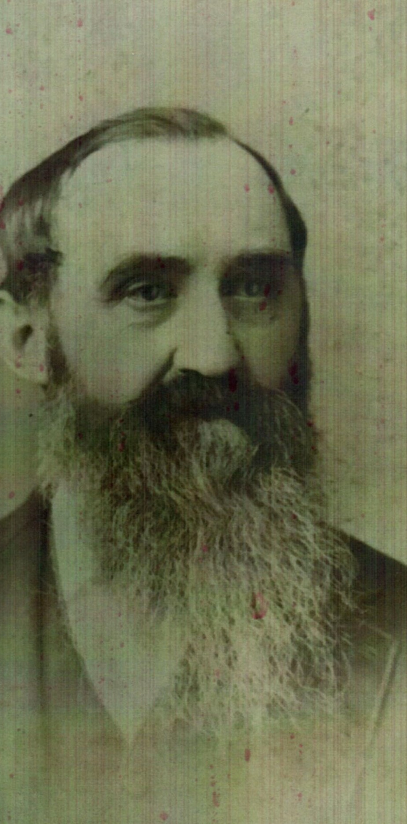
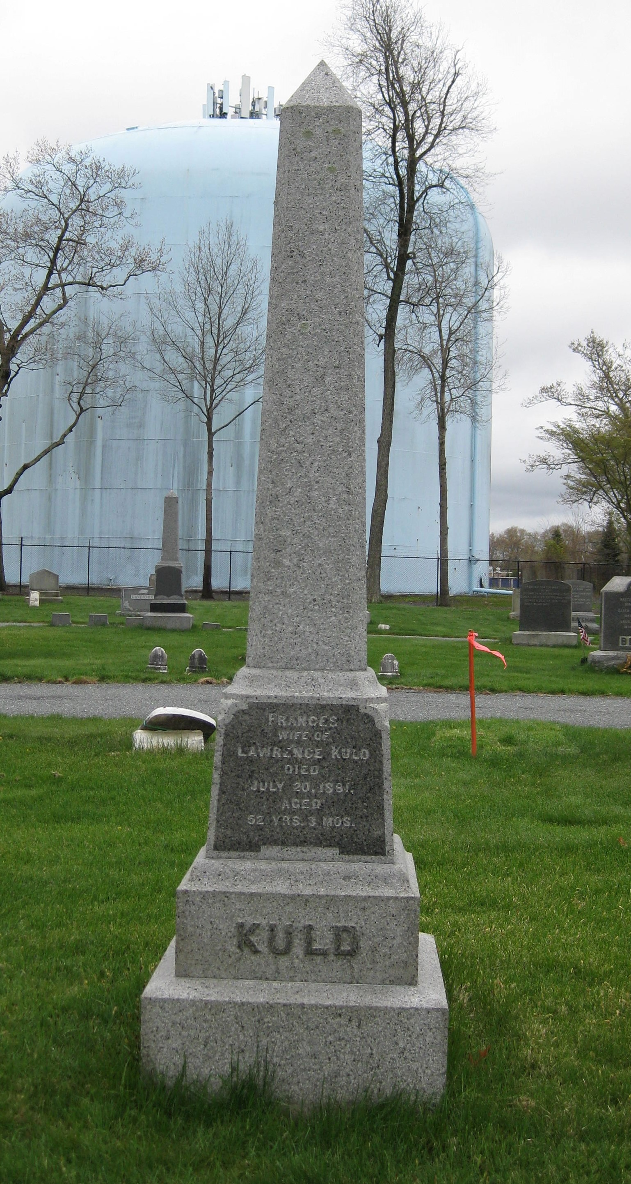
Lot #51
Lawrence Kuld (1825-1914)
Laurenz (Lawrence) Kuld was the oldest German in town when he spoke with Joe Gould in 1913 about his life in Germany and the Germantown neighborhood in Norwood. Kuld had been on the losing side of “a revolutionary wave” in mid-19th century Germany and was a fugitive for several years before emigrating to America in 1852 with his wife and daughter, Louisa. They had four more children in Norwood. Kuld worked at the tannery on Endicott Street for nearly six decades.

Slide 13
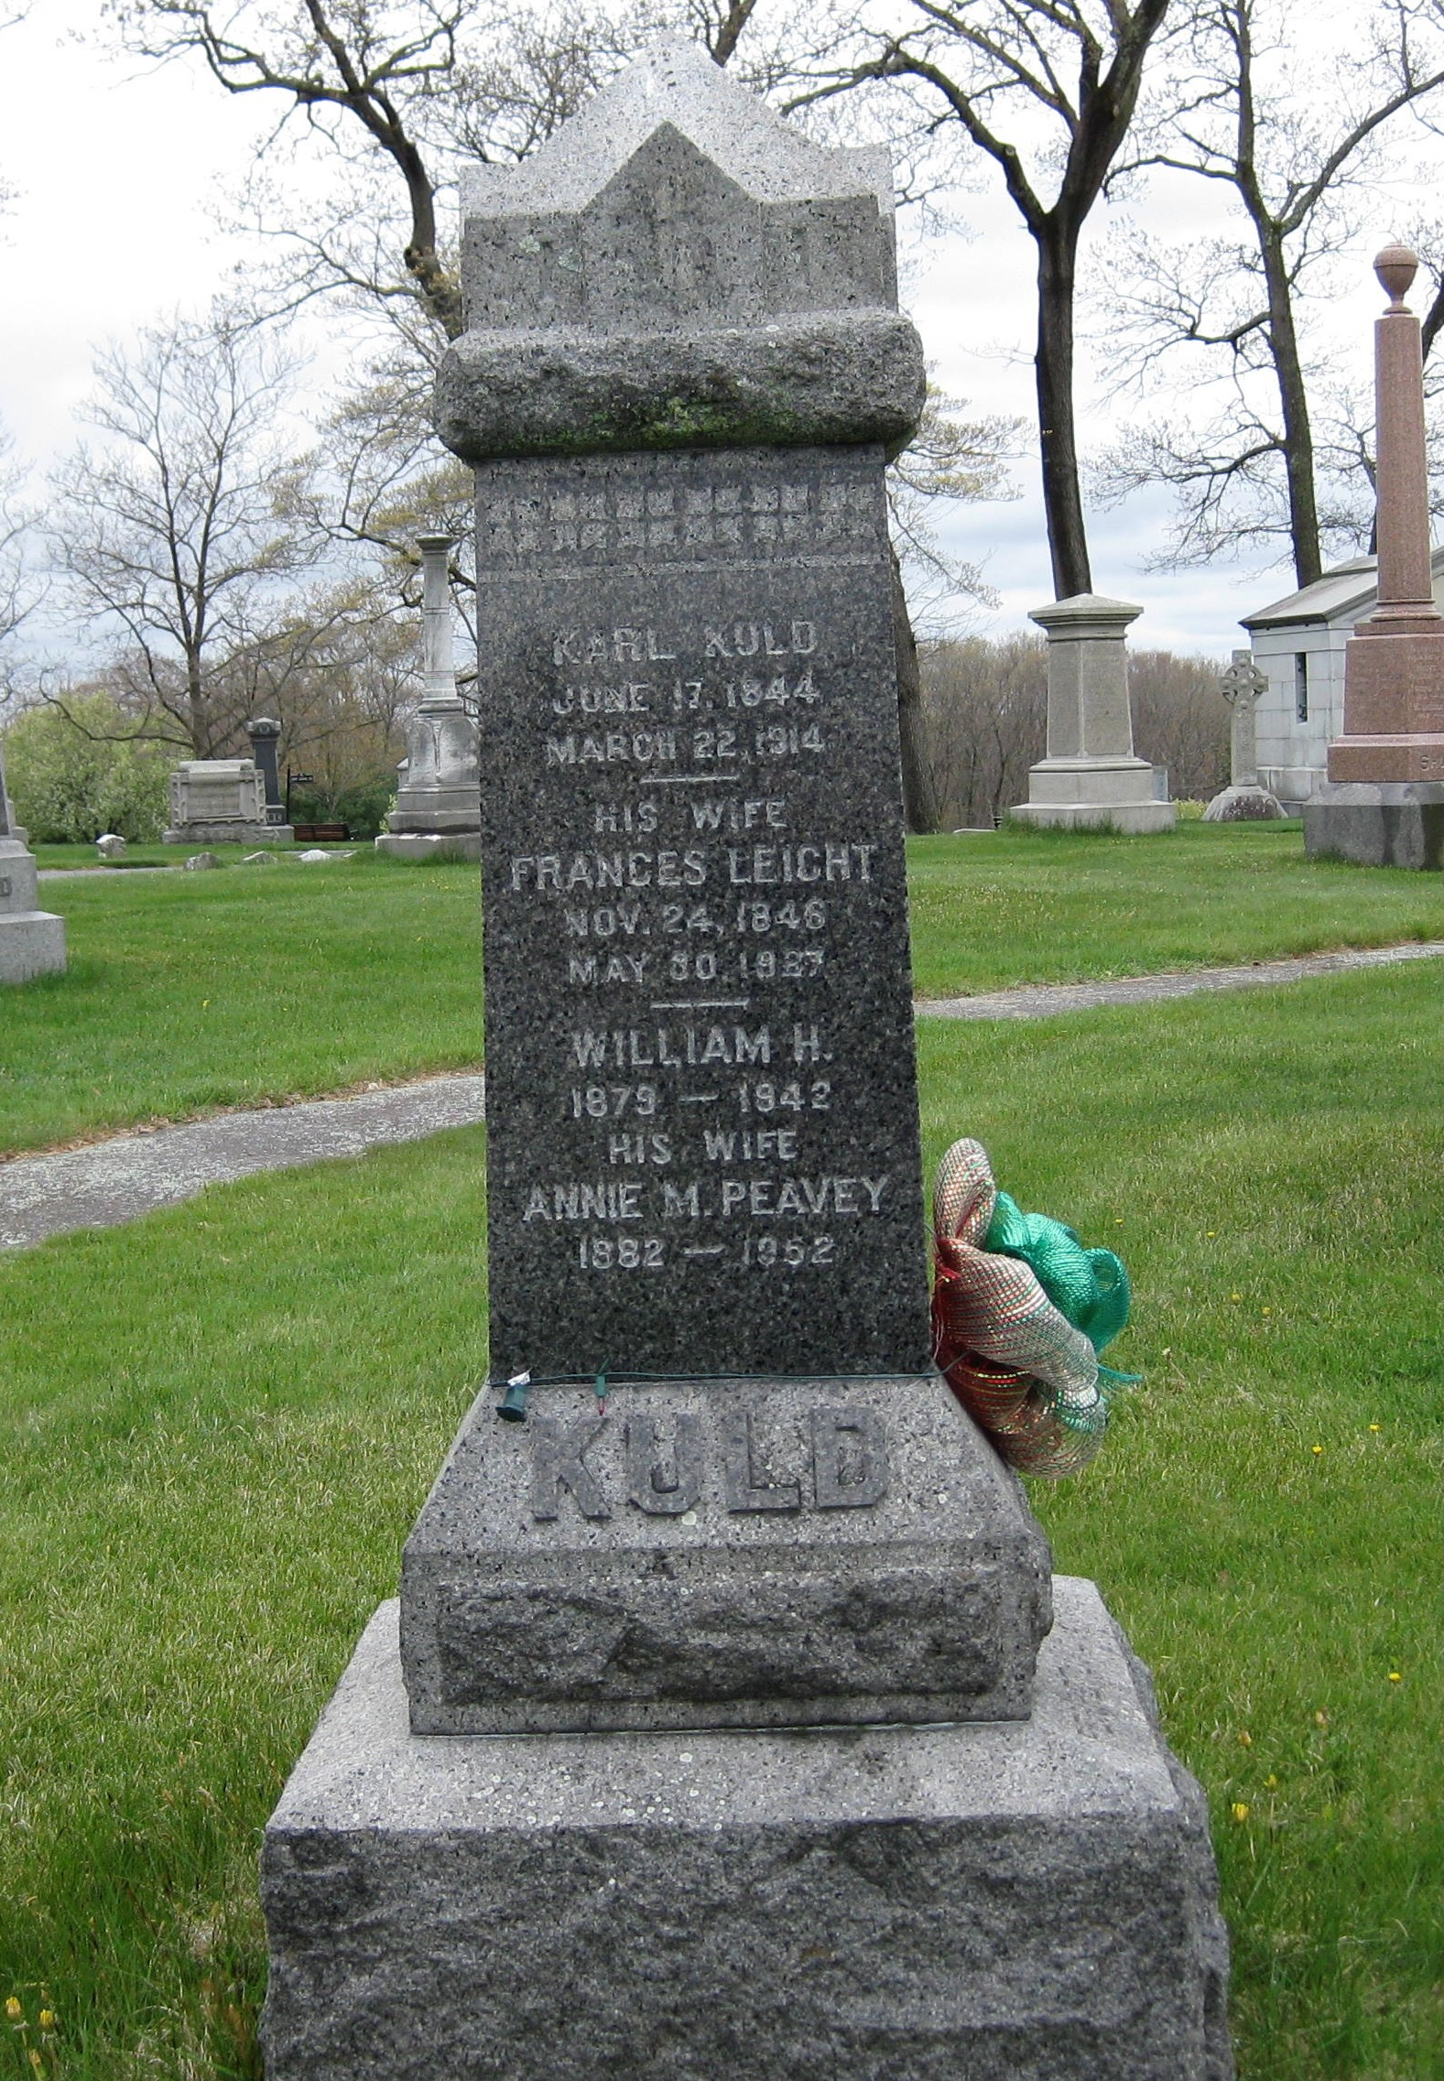
Lot #27
Karl Kuld (1844-1914)
Born on June 17, 1844 in Germany, Karl Kuld served in the army of Austria in the 1860s before he emigrated to America and Norwood. He worked at the tannery as a “shaver” and, by the early 1900s was living at 144 Walpole Street. His sons, William and Charles, branched out. William became a moulder at one of Norwood’s foundries and Charles worked at either Norwood Press or Plimpton Press.

Slide 14
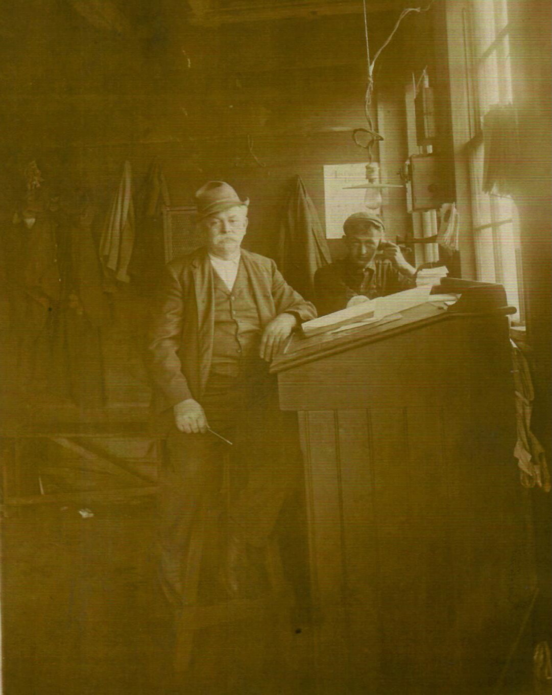
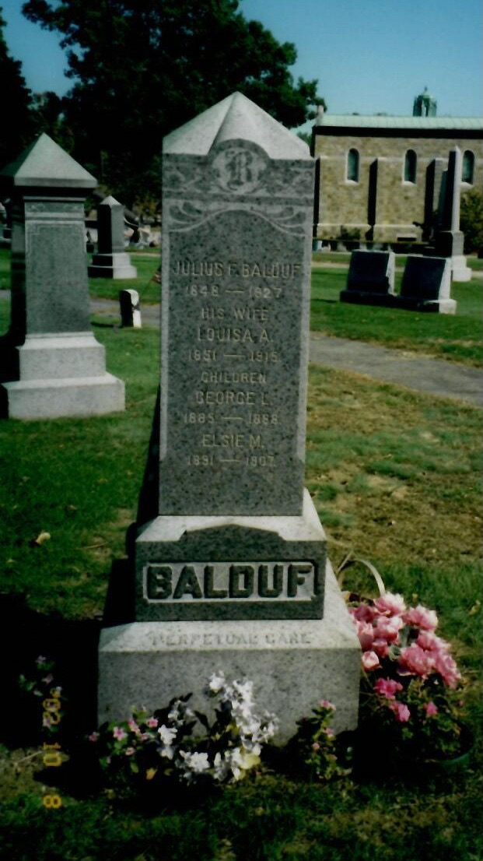
Lot #28
Julius Balduf (1848-1927)
Julius Balduf was born in 1848 in the Baden-Baden area of Germany. In the mid-1860s, he and his brothers Peter and Frederick, headed for America to avoid being drafted into Bismarck’s Prussian-led armies. He found employment at the Winslow Brothers tannery where he worked for 54 years. Balduf married Louisa Kuld, the daughter of Lawrence Kuld and they settled in Norwood’s “Germantown” on Wilson Street. He built a house at 71 Wilson where he and Louisa had 12 children, 10 of whom lived to adulthood. Balduf also operated a bowling alley on his property. On August 8, 1925, the Norwood Messenger reported that Julius was observing his 77th birthday. He was the oldest member of the Elks Lodge in Norwood and had led them in a parade in Boston the previous year. He had worked had Winslow Bros and Smith tannery for 53 years and was still working regularly. He died two years later at 79.

Slide 15
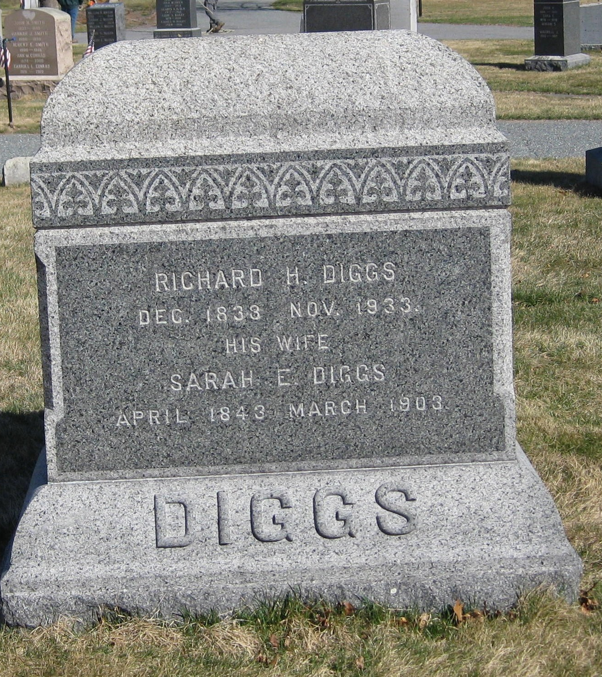
Norwood’s Pioneer African-American Families Grandison and Diggs Family
Lot #100
Richard Diggs (1839-1933)
Sarah Lyles Diggs (1843-1903)
Sometime in the early 1870s, Richard Diggs left Frederick and headed north to Walpole, Massachusetts. Why he chose Walpole is unknown but, by 1874, Richard and his wife, Sarah Lyles Diggs, had made a home there. A carpenter by trade, Richard Diggs may have worked at any number of small-scale manufacturing establishments in Walpole, but around 1885, at the age of 46, he brought his family to Norwood. He was employed at the New York & New England Railroad Car Shops as an upholsterer.
Sarah Lyles Diggs died in 1903 and, thirty years later, Richard H. Diggs died at his Washington Street home. At the time of his death, Diggs was the oldest man in Norwood and holder of the Boston Post cane, an inscribed ebony and gold commemorative stave. Distributed by the Post to seven hundred New England towns as a promotional gimmick, the walking stick was to be given to each community’s oldest resident and upon his death, was to be transmitted to the next oldest survivor. When he died, on November 22, 1933, Richard Diggs was three weeks shy of 95.

Slide 16
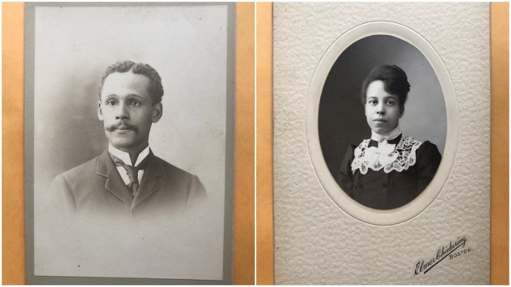
Charles Tanner Diggs (1868-1929)
Sarah Grandison Diggs (1876-1968)
Charles Tanner Diggs (1868-1929), son of Richard and Sarah Lyles Diggs, married Sarah Elizabeth Grandison. (Alfred Tanneyhill married Sarah’s sister Adelaide) Adelaide and Sarah were the daughters of William Grandison, a printer, publisher, and entrepreneur who came to Norwood when the Norwood Press arrived in town. Grandison had emigrated from Canada and was the first black man admitted to the printers’ union in Boston in 1870. After his arrival in Norwood, he lived at 473 Washington Street. In the early 1900s, he returned to Boston and opened his own business. Charles Tanner Diggs had been employed by the Winslow family as a coachman.
After his marriage, he joined his father-in-law at Norwood Press. Charles Diggs died in 1929. Sarah Grandison Diggs lived until 1968.

Slide 17
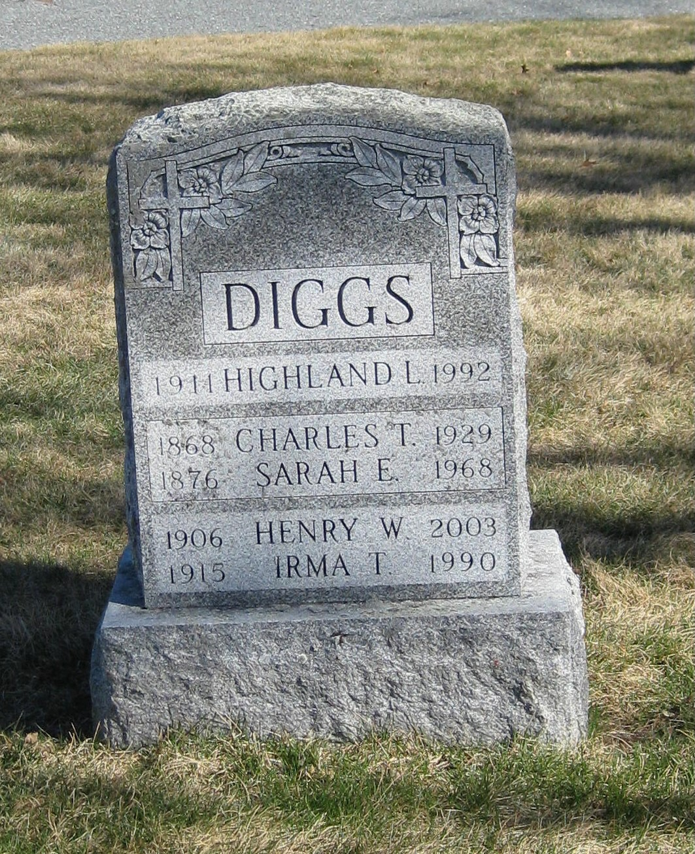
Highland Diggs (1911-1992)
Charles and Sarah Diggs’ son, Henry W. Diggs graduated from Norwood High School in 1924 and followed his father to the Norwood Press. During World War II, Henry Diggs became an Air Raid Warden and member of the town’s Committee on Public Safety, service that perhaps prompted his subsequent community engagement. In 1950, he was elected as a town meeting member and kept the position for more than fifty years. In 1957 he was appointed to the Elementary Schools Building Committee which oversaw the construction of two new elementary school buildings, a project that was successfully completed with the opening of the Charles J. Prescott Elementary School and the Frederick A. Cleveland Elementary School in November and December of 1958. The following year, Diggs was elected to the Norwood School Committee where he served with distinction for some twenty years. In 1983, Diggs was named to a committee charged with developing a Fair Housing Plan for Norwood. It was adopted in 1984, and accepted by the Massachusetts Commission Against Discrimination (MCAD). He was appointed Norwood’s first Fair Housing Director and remained on that board for ten years. A member of the United Church, the Rotary Club, and the local Elks Lodge, he was also an avid ham radio operator, and an accomplished woodworker. Henry Diggs’ wife, Irma Thompson, a graduate of Tufts University and teacher, died in 1990.

Slide 18
Highland Diggs, Henry’s younger brother, was drawn to music from an early age. By the age of 11 he was studying classical music and opera (his father Charles’ favorites) but, found the jazz sounds of Duke Ellington and Louis Armstrong irresistible. Soon he was performing jazz piano in neighboring towns with local Norwood bands after which he began playing swing dance music with a host of groups at venues from Boston to Cape Cod. Although he had plenty of opportunities to tour nationally, Highland chose to remain local and raise a family. He became a mainstay in Boston’s Scollay Square at such spots as the Imperial Café and the Crawford House. According to jazz historian, Richard Vacca, Hi Diggs was a well-regarded figure at the center of Boston’s well-regarded jazz scene. He worked regularly at The Hi-Hat, one of Boston’s most important jazz night spots where he encountered such luminaries as Miles Davis, Dizzy Gillespie, Charlie Parker, and Thelonius Monk, whom Diggs called “a genius” when he first heard him play. He also worked at the Pioneer Club, an after-hours club located on a well-hidden side street off Tremont Street. Among those who sat in with Hi’s band there were Nat “King” Cole, Count Basie, and Billie Holiday.
Highland Diggs died in 1992. He was remembered as a talented pianist, creative composer, and generous teacher who shared his musical skill and vision with countless others. A few years after Diggs’ death, a three-dimensional “music fence,” created by metal sculptor John Tagiuri, made up of a staff with notes corresponding to Hi’s composition, “Black Nairobi Moon” was placed in the Dudley Town Common, South Park, in Boston. It provides a unique and fitting tribute to a world-class musician.

Slide 19
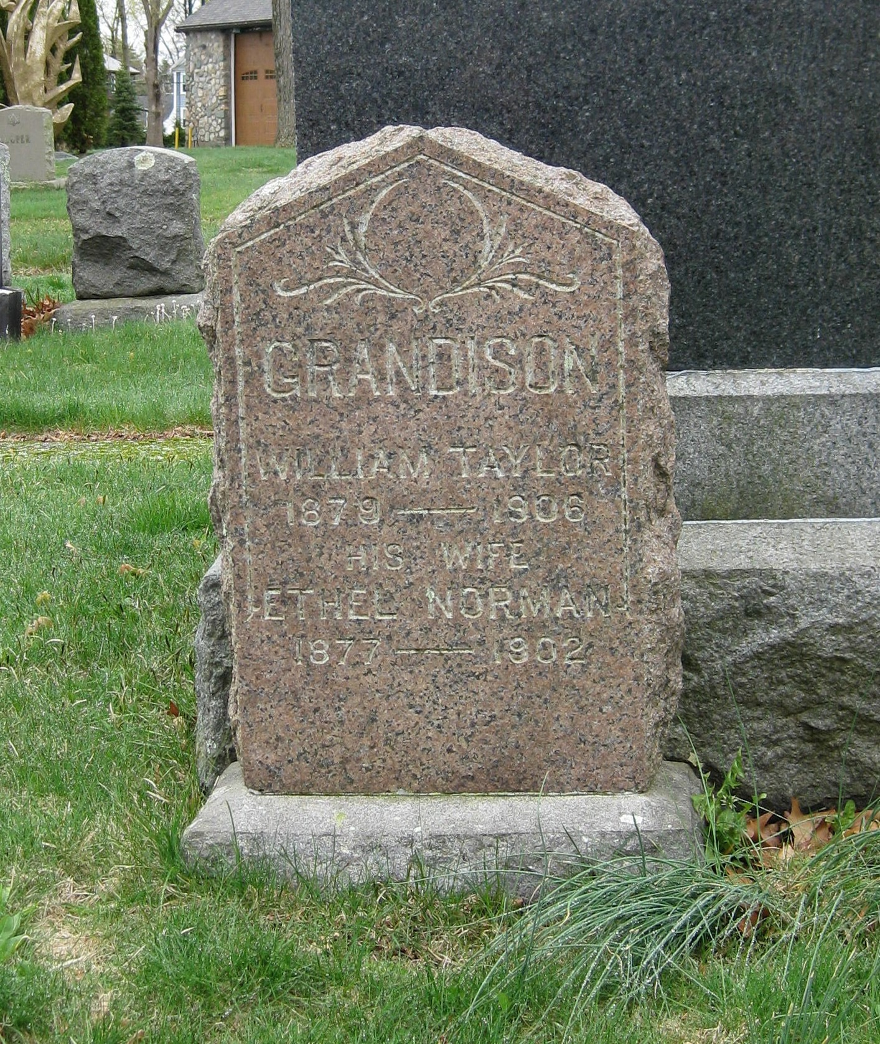
Lot # SG 75
William Taylor Grandison (1879-1906)
Ethel Norman Grandison (1877-1902)
Norman Grandison (1902-1955)
William Taylor Grandison was the son of William Grandison, and the brother of Sarah Grandison Diggs and Adelaide Grandison Tanneyhill. He came to Norwood with his father and, like his father, W. Taylor, as he was called, to differentiate him from his father, became a printer and worked at Norwood Press. He married the former Ethel Norman. W. Taylor and Ethel Grandison had a son, Norman Taylor Grandison, born on August 25, 1902. A few weeks later, on September 1, 1902, Ethel Norman Grandison died.
W. Taylor Grandison eventually moved to New York where he died on September 10, 1906 at the age of 27. His body was returned to Norwood. Their son, Norman Grandison died on November 29, 1954 in Boston and he too is buried here at Highland.

Slide 20
Irish Catholic History and Gravesites
As most of you know, Norwood began life as South Dedham (also known as Tiot), part of the town of Dedham, which was founded in 1636. More than 200 years after those first settlers arrived, South Dedham remained an almost exclusively Anglo-Saxon Protestant village of less than 1000. Then things began to change. As fate would have it, just as the Norfolk County Railroad was expanding through the center of the village, and two large tanneries, a furniture factory, and an ink mill were seeking workers, the Irish were being driven from their home country by a disastrous multi-year potato blight and subsequent famine.
These first Irish immigrants came primarily from the west of Ireland. At the outset, they were desperately poor and willing to take on any work to survive. A man with farming skills could secure a place on one of several farms in the area; many others found employment not only on the railroad but at industrial sites such as Willard Everett’s furniture factory, Fisher Talbot’s carpet shop, George Morrill’s ink mill, and the Winslow and Smith tanneries which were particularly popular places of employment.
They found housing at the former freight barn belonging to the Moses Guild family on the site of today’s Guild Square Park. With the coming of the railroad, the need for Guild’s freight business waned and the wagon house became a mill and then a factory. When the Irish arrived, it was converted into a kind of tenement with small rooms, oil lamp lighting, and a single outhouse. Several families crowded into the haphazardly renovated building which had playing cards – one of the previous uses of the building – covering its walls.
After a few years of steady employment and frugality, most tenants of the steam mill settled into two enclaves, one came to be called “Dublin,” located along Railroad Avenue, west of Washington Street, and the other, “Cork City,” stretched out to the east of Washington Street. Within these neighborhoods, they created a flourishing community of their own.
These are some of those early Irish pioneers.

Slide 21
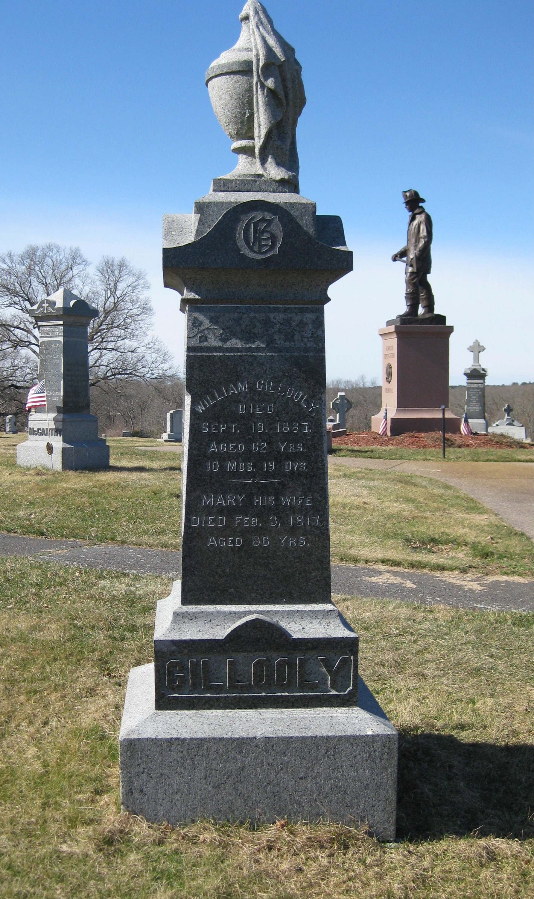
Lot #526
William Gillooly (c1820-1887)
John Gillooly (1855-1941)
William Gillooly was an Irish immigrant who arrived in Norwood in the 1850s, after the Great Famine. He was a stone mason. William Gillooly was the first Catholic to be buried in Highland Cemetery in 1887. His son, John J. Gillooly, found local politics and business to his liking. John was born in the Cork City neighborhood and lived in Norwood all his life. Like his father, he started out as a mason and builder but, before too long, he became a well-regarded undertaker with an office in the center of town and a home at 126 Walpole Street – still the site of Gillooly’s Funeral Home. Gillooly was involved in many civic projects, was one of the first trustees of the Municipal Light Department, and was the first Irish-American to be elected to the Board of Selectmen in 1891.
John J. Gillooly

Slide 22
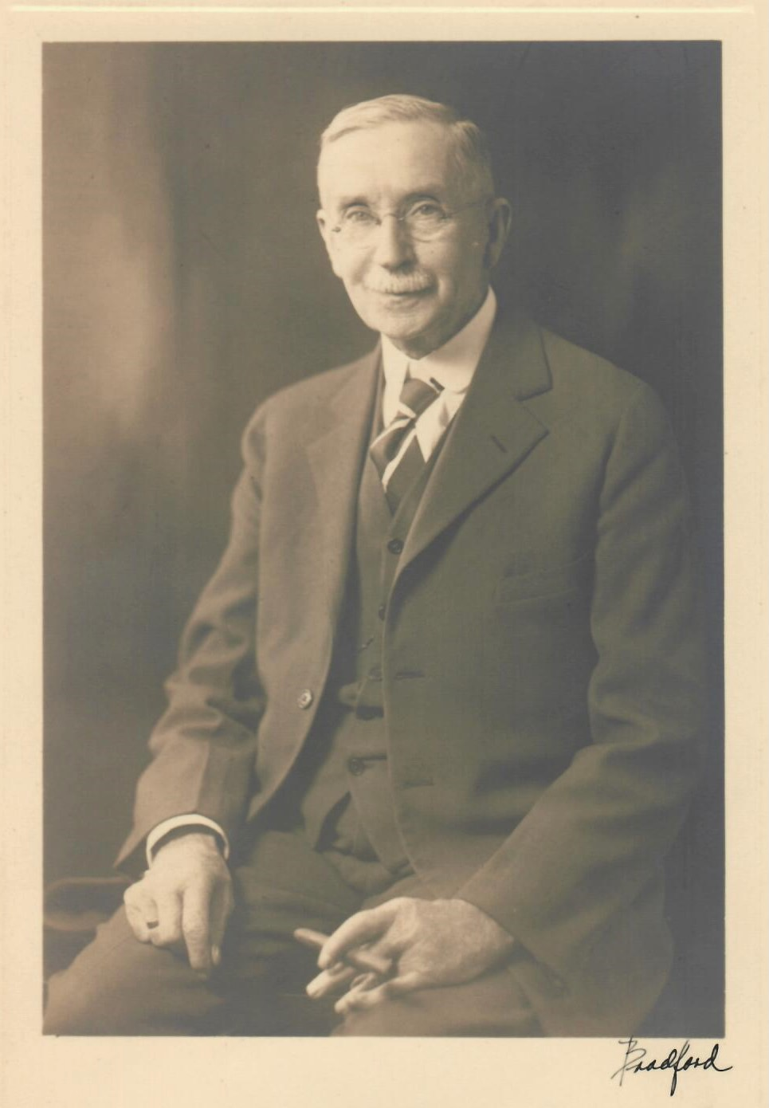
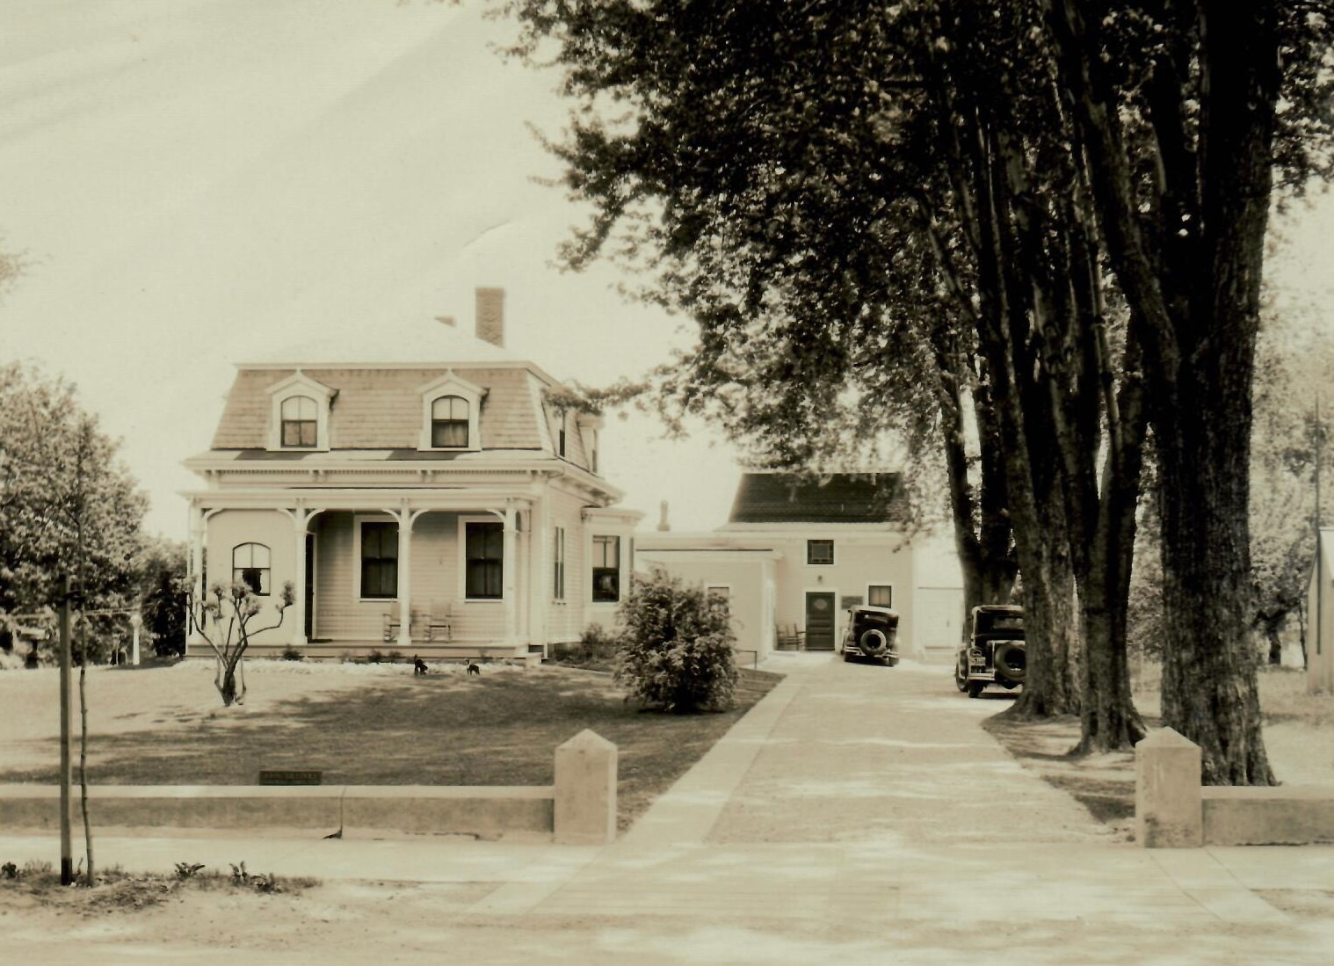
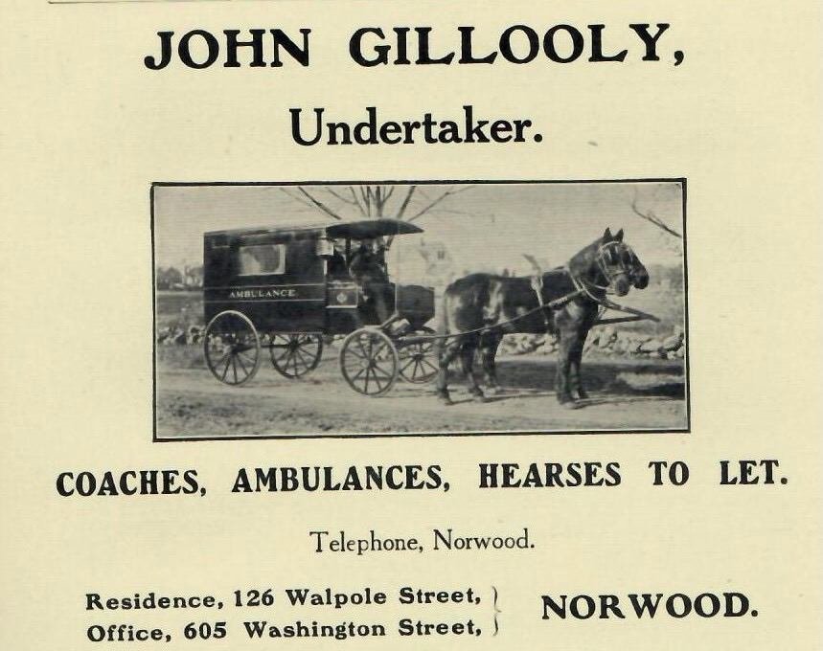
John J. Gillooly

Slide 23
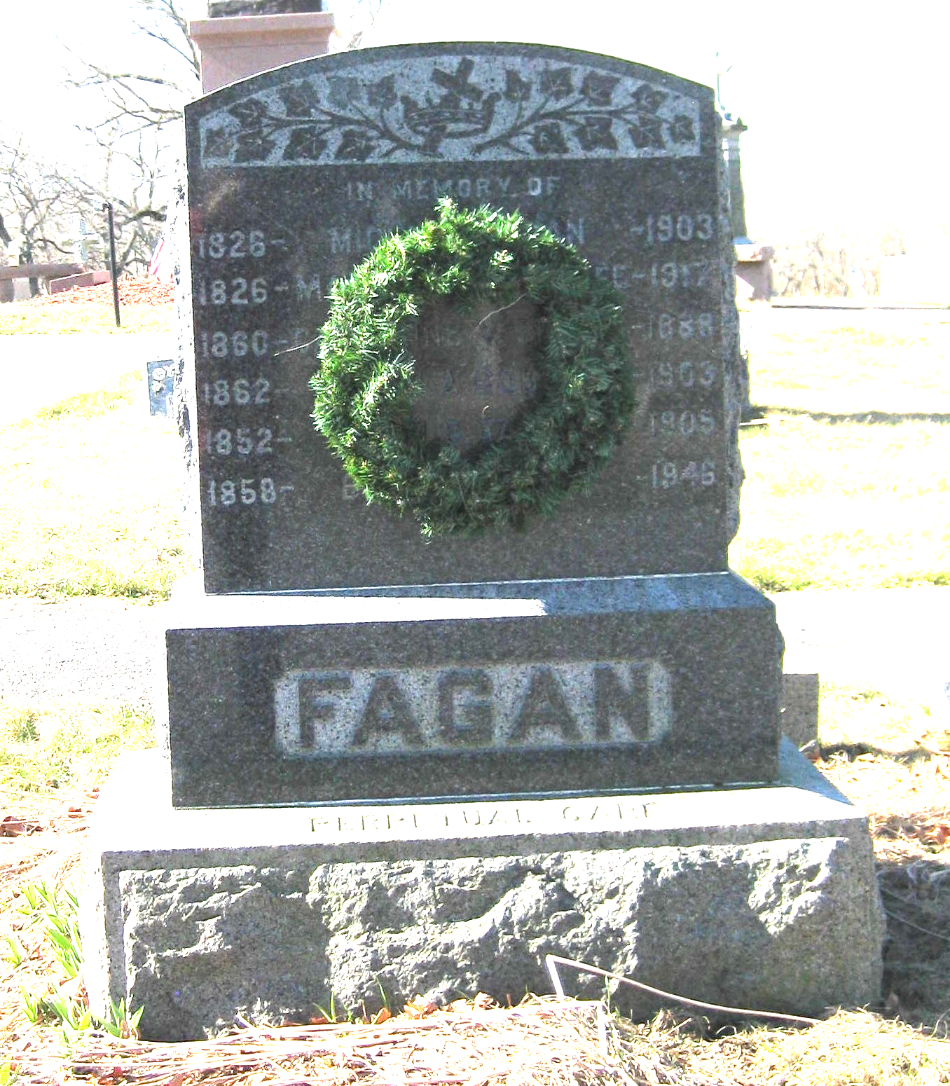
Lot #511
Michael Fagan (1826-1903)
Most significant to this growing ethnic community was the establishment of the Catholic Church. Michael Fagan, one of the town’s earliest Irish immigrants, later recalled the events that led to the formation of St. Catherine of Siena parish. Arriving in Boston in September, 1847, he came upon South Dedham where he found employment on a farm, acquired a room in the steam mill, and learned there was an “Irish Church” in Canton (and another in Roxbury). He promptly joined the nearly one hundred laborers who walked the “hard, lonesome road to Canton” to hear Mass “in a small stone house” near the viaduct. This was the practice until November, 1848, when a missionary priest passing through South Dedham offered to say Mass in a private home. By 1860 as the number of Catholics continued to climb, a succession of priests began to hold Mass on a semi-monthly basis, often in Village Hall, rented for that purpose by Irish immigrants Richard and Abbie Oldham. This practice continued until 1862 when the Universalist Society of South Dedham erected a new church on the corner of Washington and Nahatan Streets, and offered to sell their former building to the Catholics. Later known as Columbia Hall, the building stood where today’s St. Catherine’s school hall is.

Slide 24
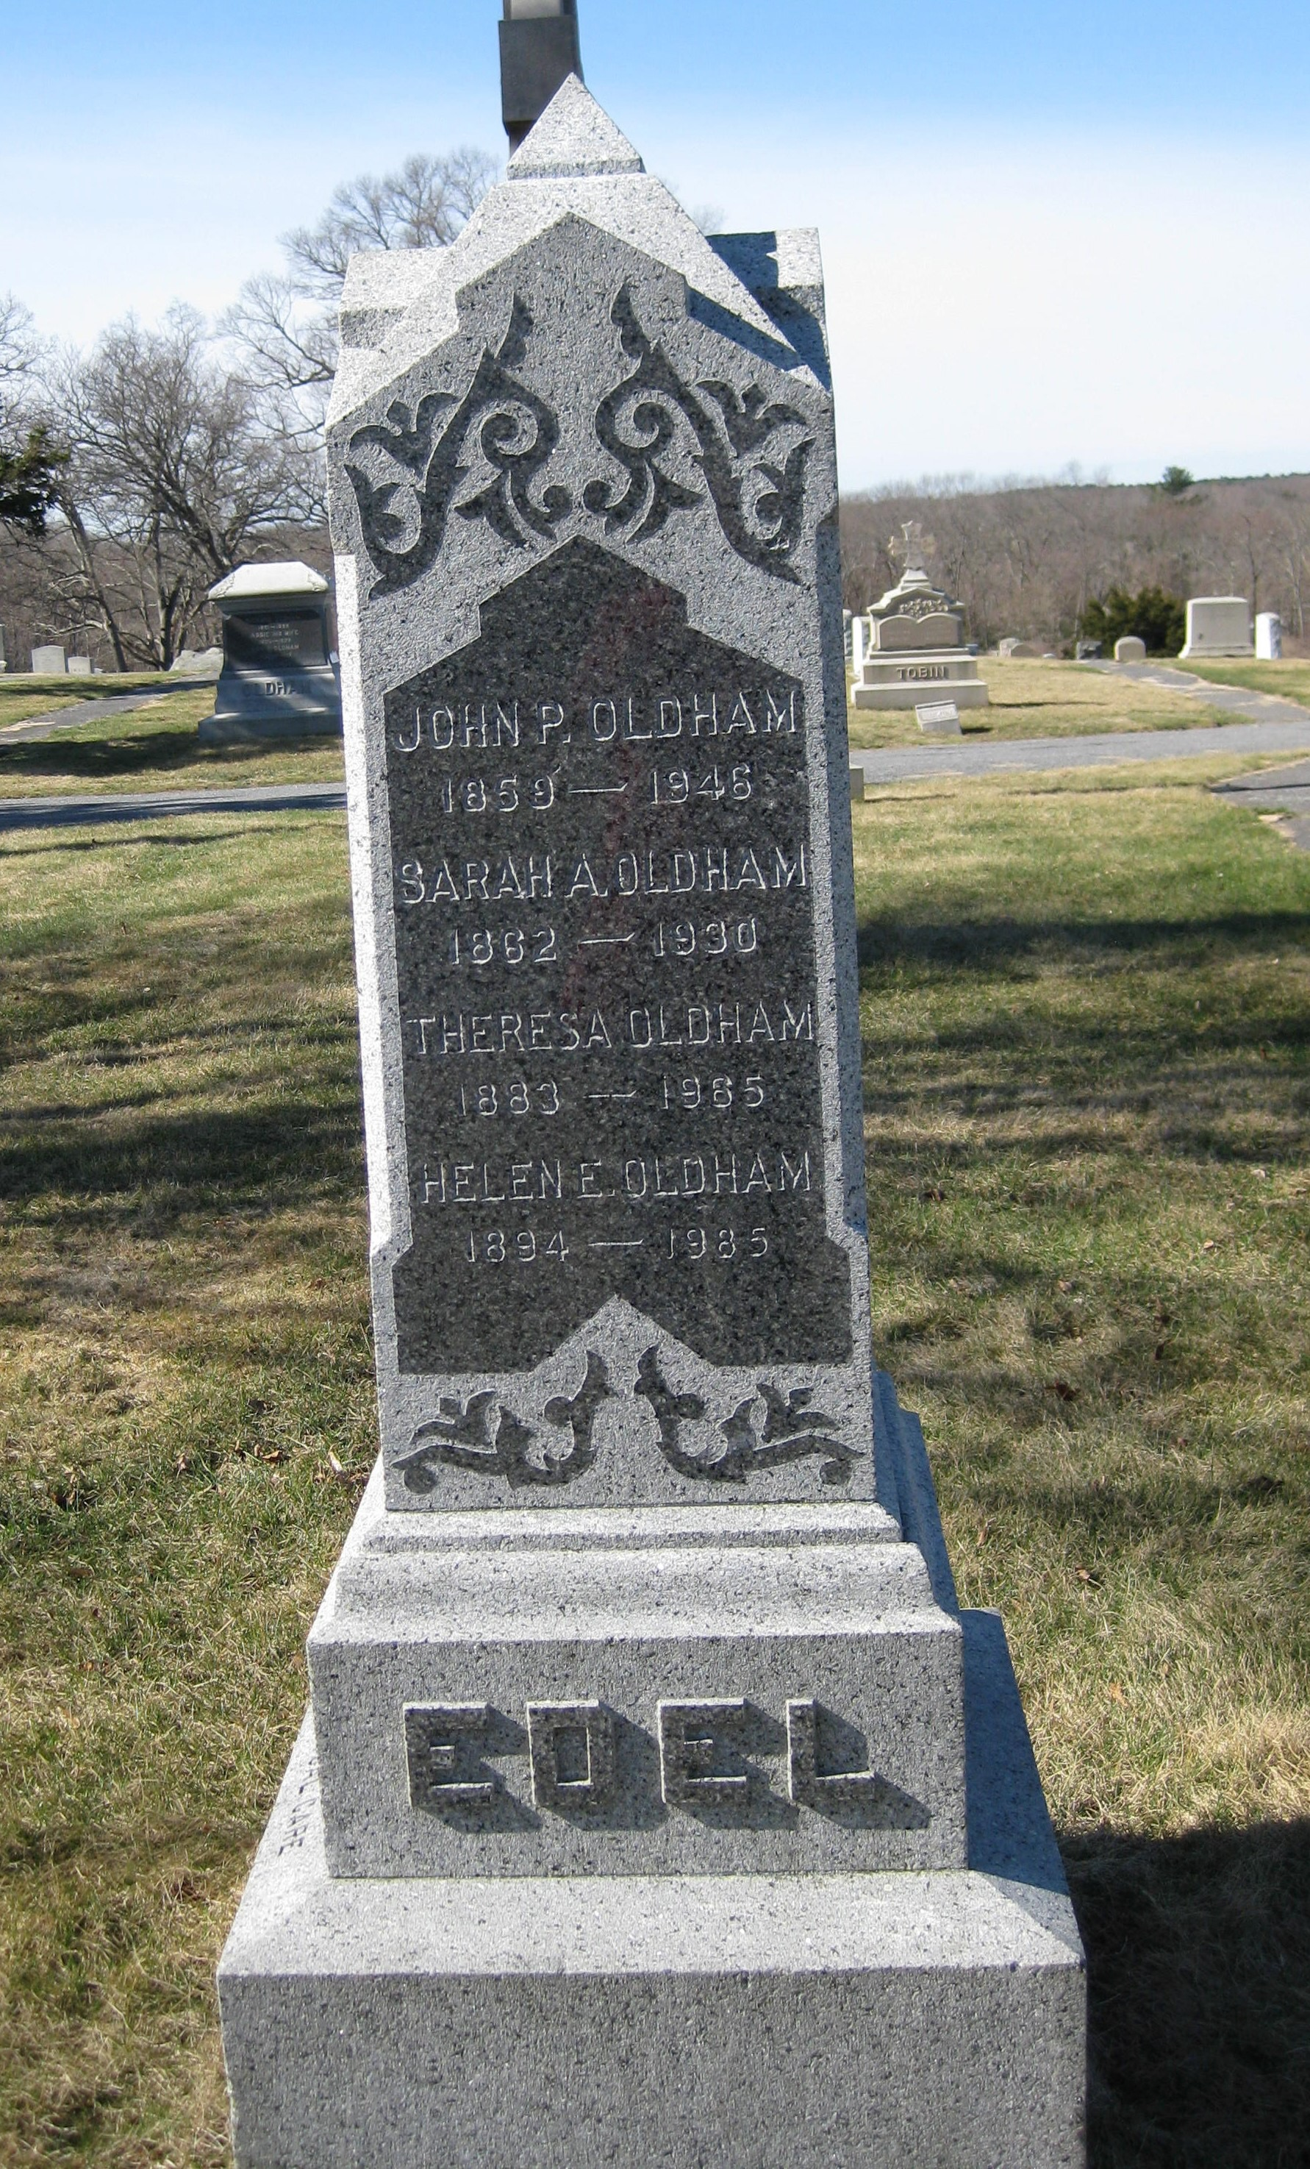
Lot #530
John P. Oldham
John P. Oldham, was born in 1859 in South Dedham. His parents were Richard Oldham and Abbie Linnehan Oldham, who were among the earliest Irish immigrants to arrive in this town. John P. Oldham worked for the railroad as a fireman, then worked as a custodian for the Norwood School Department in 1900. He became the supervisor of custodians, buildings, and grounds for the public schools, retiring in 1938. He died in 1946. The John P. Oldham Elementary School was named for him in 1963. Norwood’s middle school is named for his grandson Philip Oldham Coakley, who was born in town, served in World War II in the Pacific, and became Superintendent of Schools in Norwood.

Slide 25
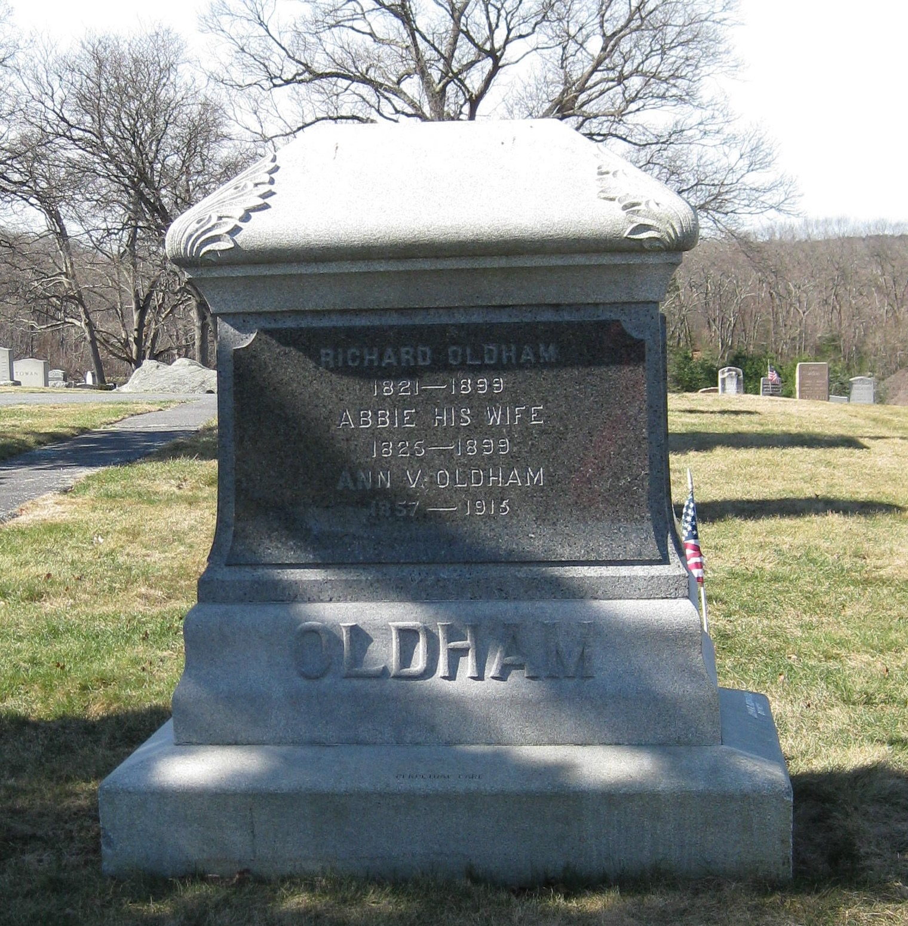
Lot #683/684
Richard Oldham (1821-1889) & Abbie Linnehan Oldham (1826-1899)
Like many Irish immigrant women, Abbie Linnehan became a domestic servant after her arrival in America. She lived and worked in the home of Mr. and Mrs. Ebenezer Dean until her marriage to Richard Oldham. The couple spearheaded the founding of St. Catherine of Siena parish.
Their son, Richard E. Oldham, born in 1855 in South Dedham, attended village schools and became a station agent for the New York & New England Railroad. In 1899, he quit the railroad to became an insurance agent. He served as selectman for the town of Norwood from 1901 to 1911. Another son was John P. Oldham, whose story can be read above.

Slide 26
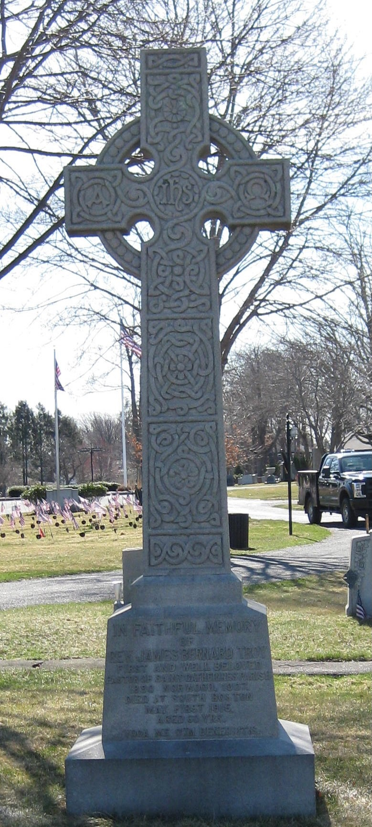
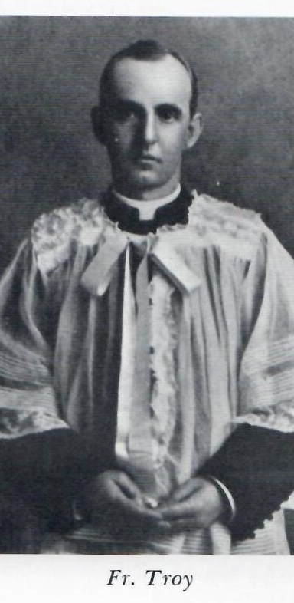
Lot #531
Father James Troy (c1855-1915)
Father James Troy was ordained in 1877 and arrived in Norwood in 1890. He was the first resident pastor for St. Catherine of Siena Church, the community’s first Roman Catholic Church. He oversaw a rapid expansion of the parish during his seventeen years of service. Troy was beloved by his congregation and the entire town. At a banquet given in his honor at Village Hall in 1895, he acknowledged their bond saying: “Happy am I that the heart of the priest and the heart of the people are united as they are in Norwood. One we have ever been. Please God, one we shall be until the end.” That bond continued even after he was transferred to St. Vincent’s in South Boston in 1907. Late in April of 1915, Father Troy was stricken with appendicitis and died on May 1. On May 3, his body was returned to Norwood. All stores and public offices were closed for his funeral and when the horse which was to lead his funeral cortege balked, men of the parish pulled the wagon carrying the casket to Highland Cemetery where their beloved pastor was buried. On Sunday, October 22, 1917, this large Celtic cross was placed above his grave.

Slide 27
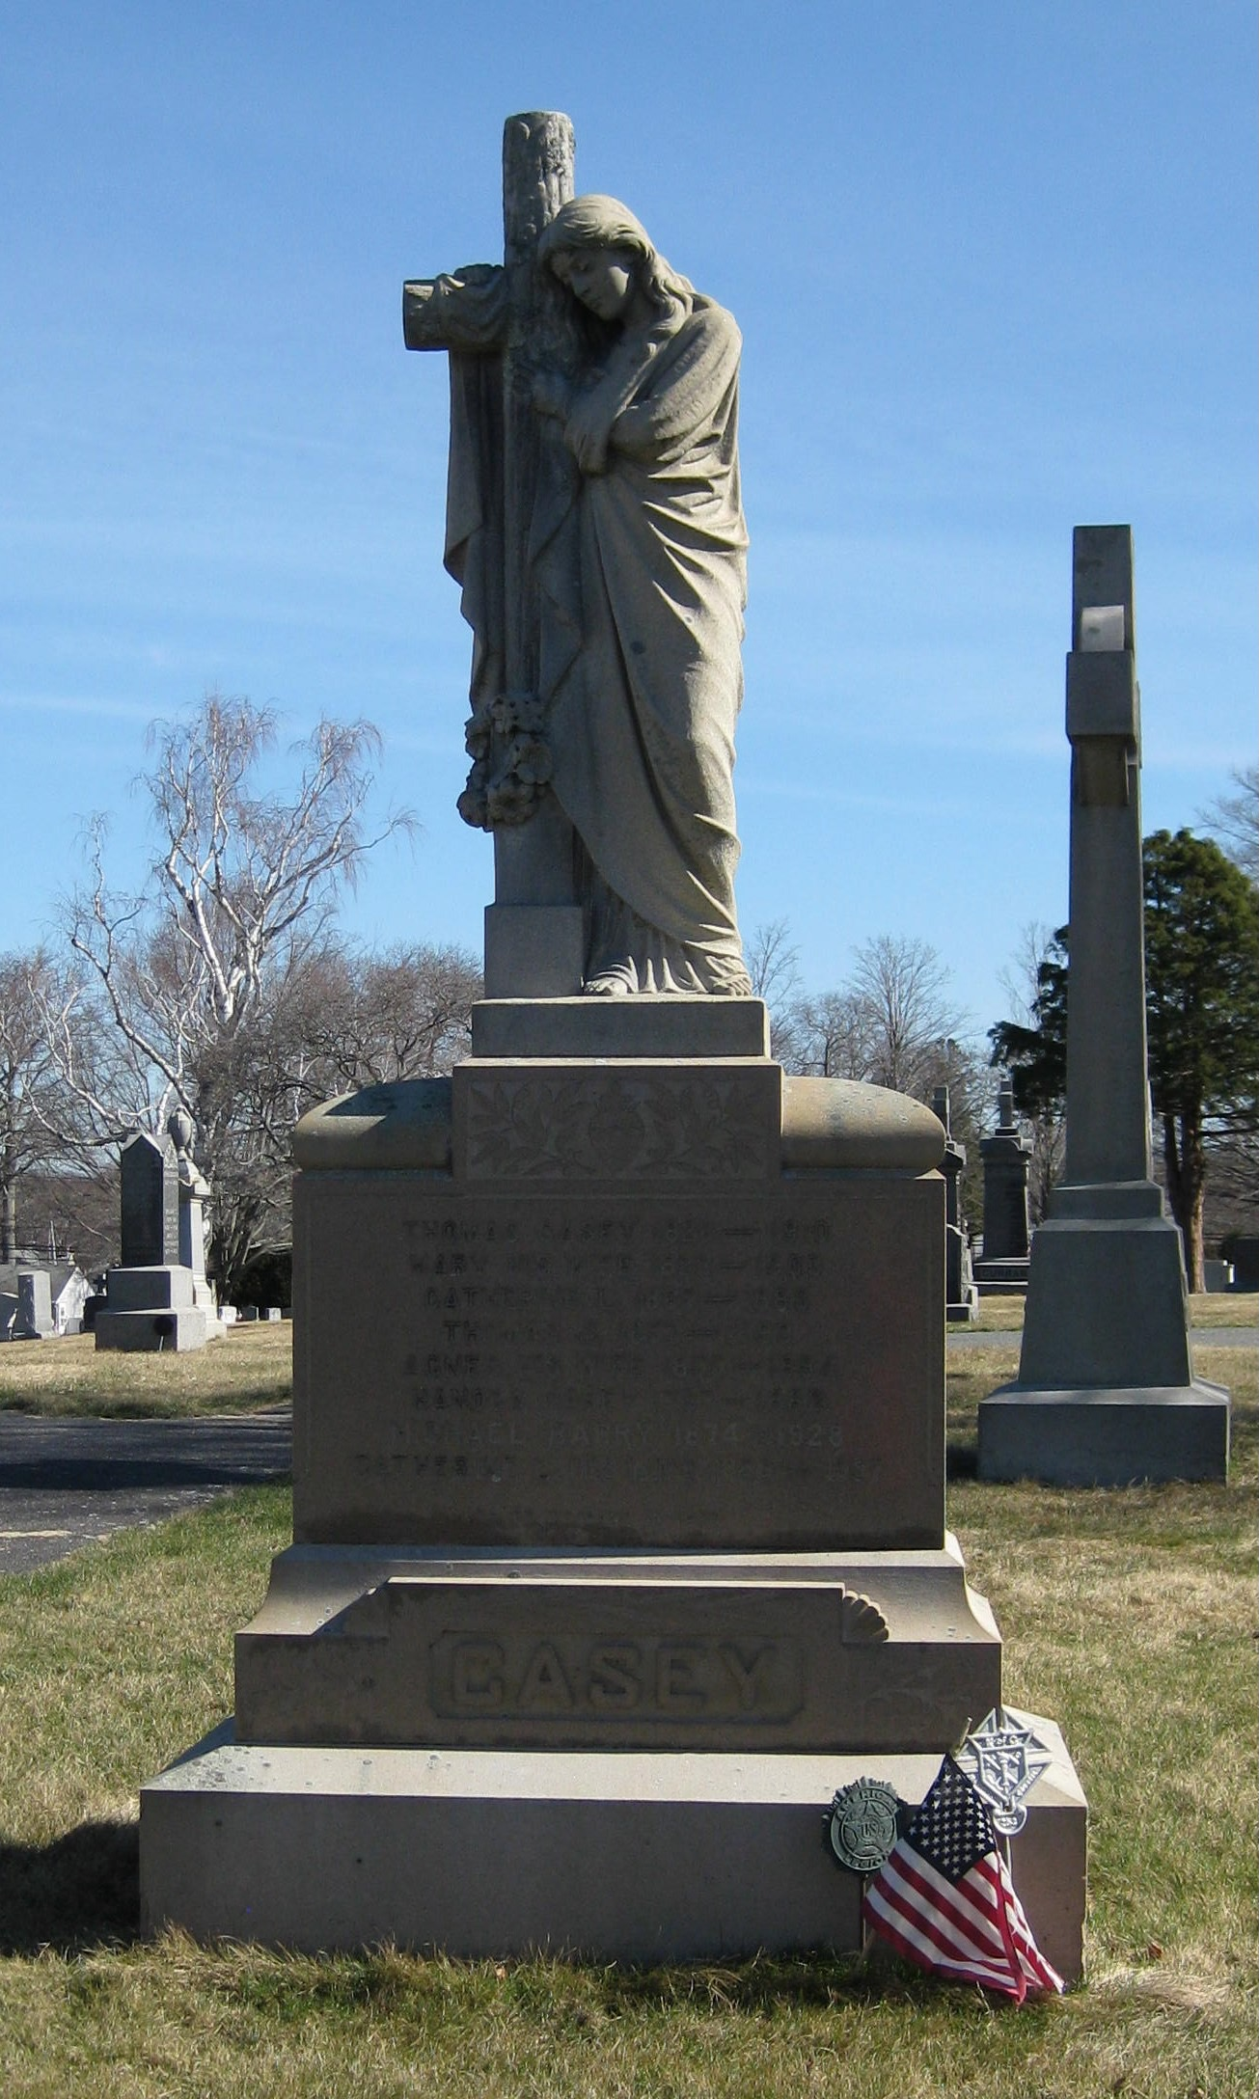
Lot # 532
Thomas Casey (1826-1910)
In addition to the founding of St. Catherine’s parish, the Norwood Irish started their own neighborhood stores with Thomas Casey’s in Cork City leading the way. T. J. Casey, born in County Cork, Ireland in 1826, emigrated to America in 1850 and settled immediately in Moses Guild’s tenement. He worked at the tannery, the South Dedham Tavern, and was a partner in the Bell & Casey foundry prior to opening his grocery business. In 1882, Casey erected a community building behind his store which became the center of neighborhood social activities including public concerts, dances, weddings, and private parties. Casey Hall became the home of the Norwood chapter of the Ancient Order of Hibernians (A.O.H.). Founded in 1880 by Patrick Spillane, Patrick Walsh, Edward Fay, and Thomas Casey himself, the A.O.H. became one of the town’s most popular fraternal organizations. Its stated purposes “to promote the friendship and unity of Irish Americans, to give aid to widows and orphans, to provide for the sick, to befriend the stranger, and to support the cause of an independent Ireland” were maintained well into the twentieth century. Casey Hall also was the meeting place for those workers who first wished to unionize at the tanneries and ink mill.

Slide 28
Norwood’s Jewish Population and Highland’s Jewish SectioN
The first Jewish family arrived in Norwood in 1899 and others followed. In 1907, several men banded together and bought a Scroll (Torah) and a Siem ha Torah was held in Conger Hall. The Norwood Hebrew Congregation was chartered on April 6, 1908, and for a few years services were held only on High Holidays in various halls around town (Conger Hall, Odd Fellows Hall, and the Elk’s Building). Around 1915 a Jewish Women’s Club was formed and a Sunday School started in 1917. This became a daily school in September, 1917. The Norwood Civic Association allowed use of its Model House for these classes without charge. Eventually, the congregation rented a room on Washington Street and then a small building on Chapel St. In 1924, land was purchased and a building project began. The first synagogue in Norwood was dedicated on August 30, 1925. Services were conducted by members of the congregation until 1941 when the first ordained Rabbi began to preside. By 1947, when Norwood was celebrating its 75th anniversary, among the officers of the synagogue were: Otis Cooper, President; Morris Danovitch, Vice President; and Louis Orent, Treasurer. In 1966, the congregation moved from 933 Washington Street to 556 Nichols Street; the building was designed by Rudolph Bedar, a local architect. The synagogue remained there until 2009 when the building was sold to the Jain Center and the congregation moved to Commerce Way. Due to changing demographics and an aging membership, the congregation merged with one in Sharon in 2017.
Sometime in the mid-1950s, this section of Highland Cemetery was set aside for the Jewish population.

Slide 29
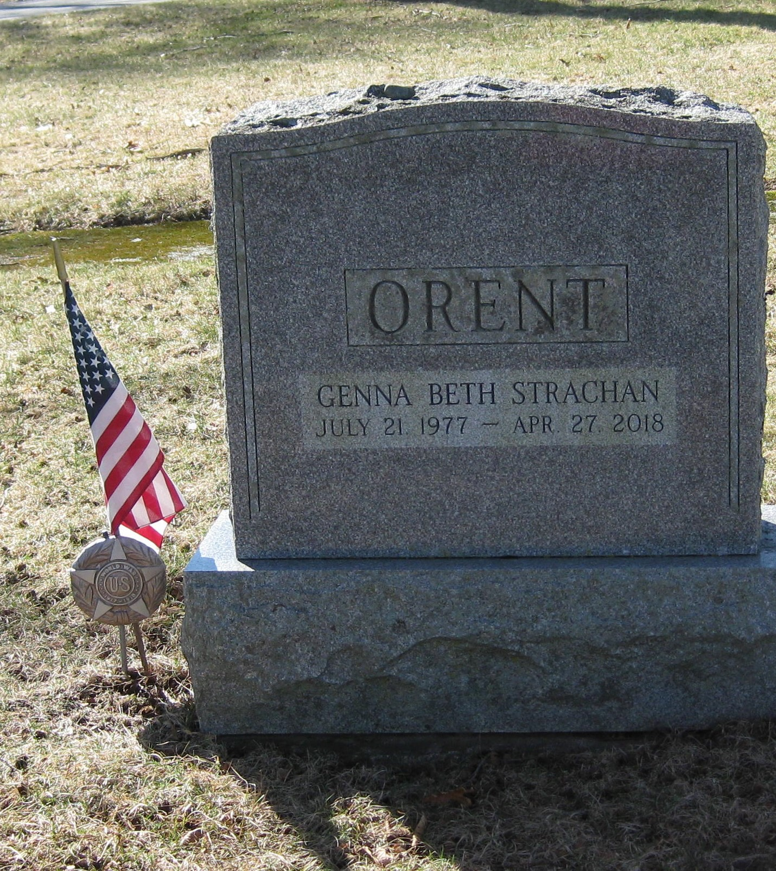
Lot #902
Louis Orent (1888-1983)
Louis Orent was born on November 20, 1888 in Poland. He was raised on Cape Cod. He opened Orent’s clothing store in Norwood with his brother, Herman, in 1912. The store was located on Guild Square for its first 15 years, then moved to Washington Street. In 1962, a new store was opened across from the town common. Louis and his wife, Bebe, were the catalysts behind a host of community service organizations. He was the founder of the Norwood Merchants Association and served as its president for a number of years. He was the founder of the Community Chest, now the United Fund, was a member of the Norwood Hospital board of trustees and a director of the Norwood Co-operative Bank. Orent was a World War II Navy veteran. He acquired a long list of accolades for all he did for Norwood and its residents. He was a member of the Norwood Elks, the Norwood Servicemen’s Fund, the Greater Boston Advisory Board of the Salvation Army, the Norwood Chamber of Commerce, and the Rotary Club. He was one of the founders of Temple Shaare Tefilah in 1926. Orent was given a citation for his 50 years of community service by the Chamber of Commerce in 1962. Orent’s Clothing Store was one of the most well-known establishments in the area and, in 1966, was named the retail outlet of the year by the National Brand Name Specialty Store Association. He was remembered fondly for his kindness and thoughtfulness. Louis Orent died on May 13, 1983, in Hollywood, Florida, where he had retired.

Slide 30
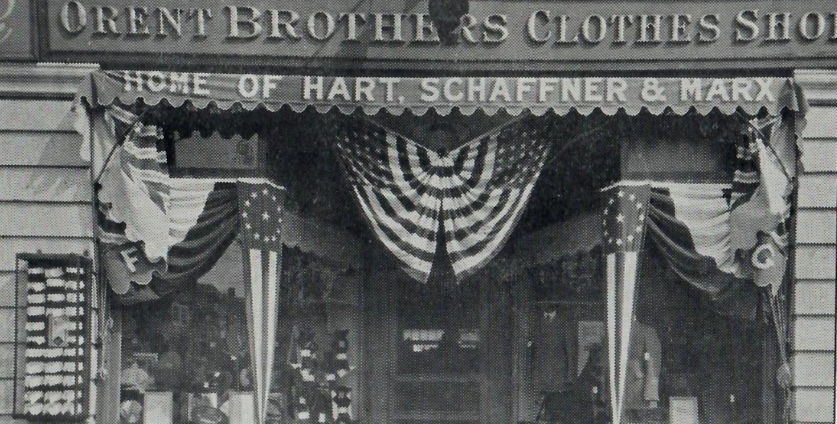

Slide 31
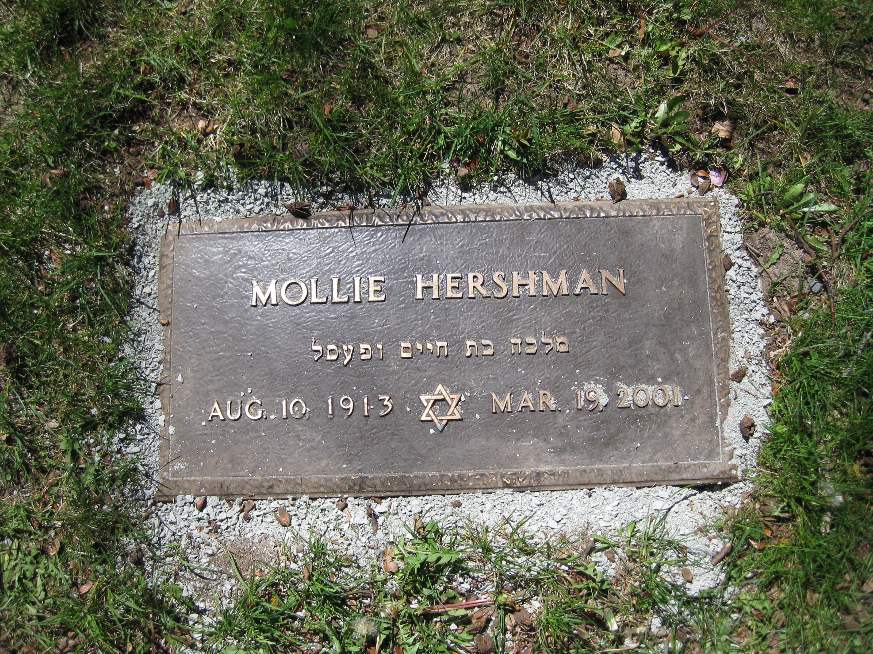
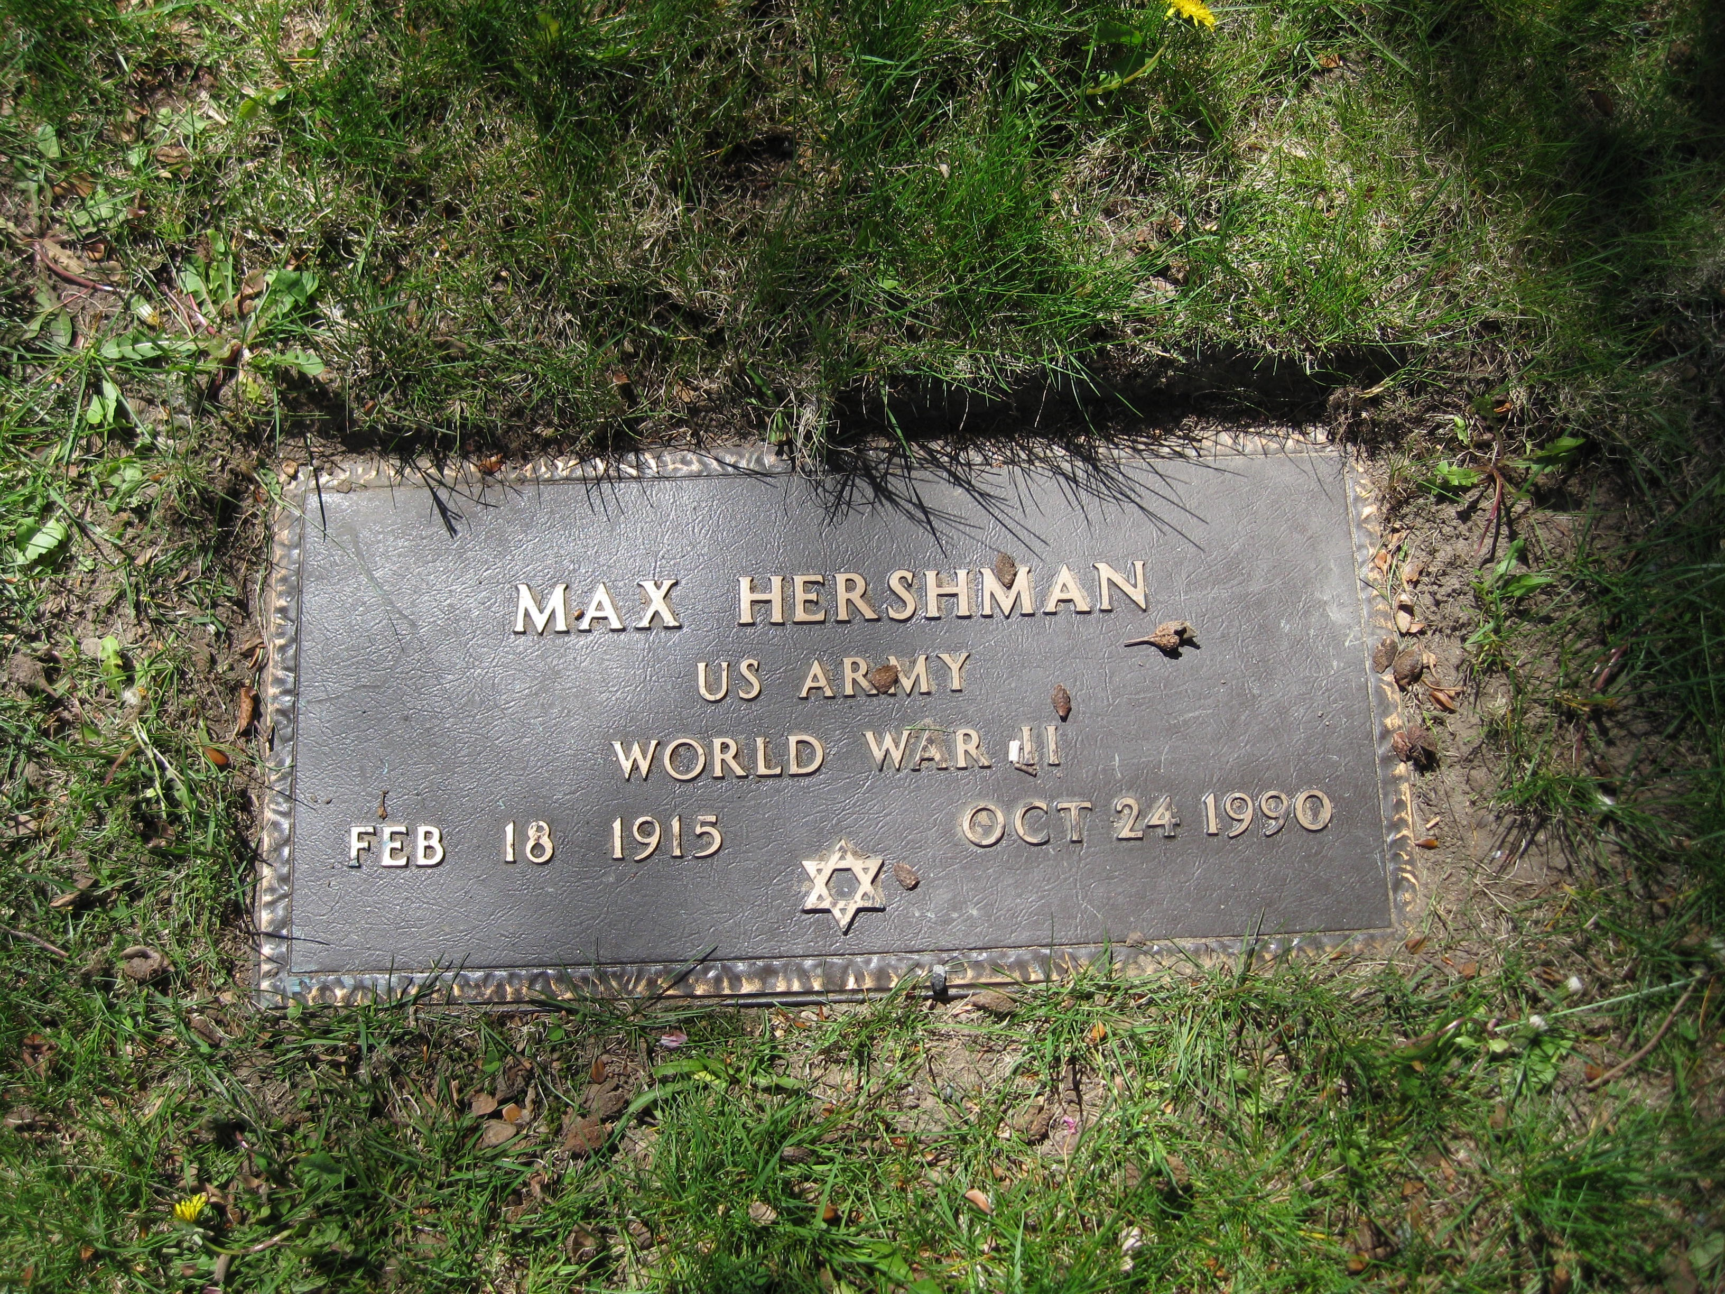
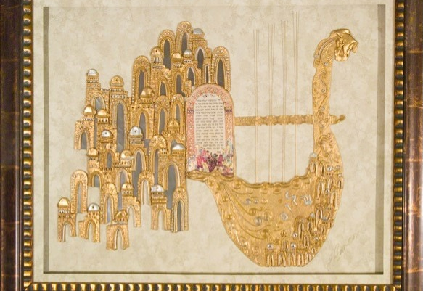
Lot #906
Max Hershman (1915-1990) and Mollie Hershman (1913-2001)
Max and Mollie Hershman were the thirtieth Jewish family to settle in Norwood. They joined the Temple Shaare Tefilah, then located on Washington Street, in 1948. When the synagogue relocated to Nichols Street in 1966, Max Hershman was one of the congregants who carried the Torah from the old building to the new. Max Hershman was an optometrist for more than 40 years; Mollie was a nurse at Sharon Country Day Camp, a member of the Norwood Women’s Club and offered knitting lessons for Norwood’s recreation department. In addition, both Max, who had joined a jazz band in college, and Mollie were devoted to music. After her three children entered Norwood schools, Mollie advocated for the music program. She reorganized the band’s parents group into the Norwood Parents Music Association in the early 1960s and rallied support for music offerings throughout the schools. It was Mollie’s wish that the Norwood High music program have a harp, a prestigious instrument for a high school to have. Her wish and donations following her death in 2001 brought about the gift of a harp to Norwood High in 2001. In 2003, the Hershman children, Sue-Ellen, Joel, and Judi, commissioned a piece of art – King David’s Harp by Orna Amrani, an Israeli artist – in memory of their father for Norwood’s synagogue. It was dedicated and hung in the temple until the building was sold. It now resides at a temple in Stoughton.

Slide 32
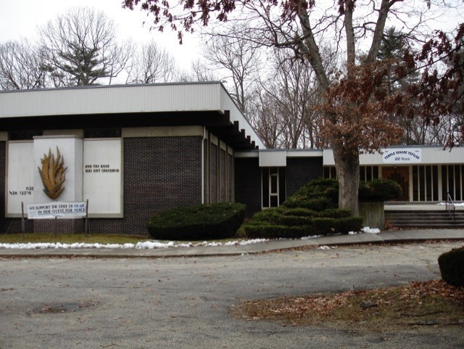
Temple Shaare Tefilah at its Nichols St. site

Slide 33
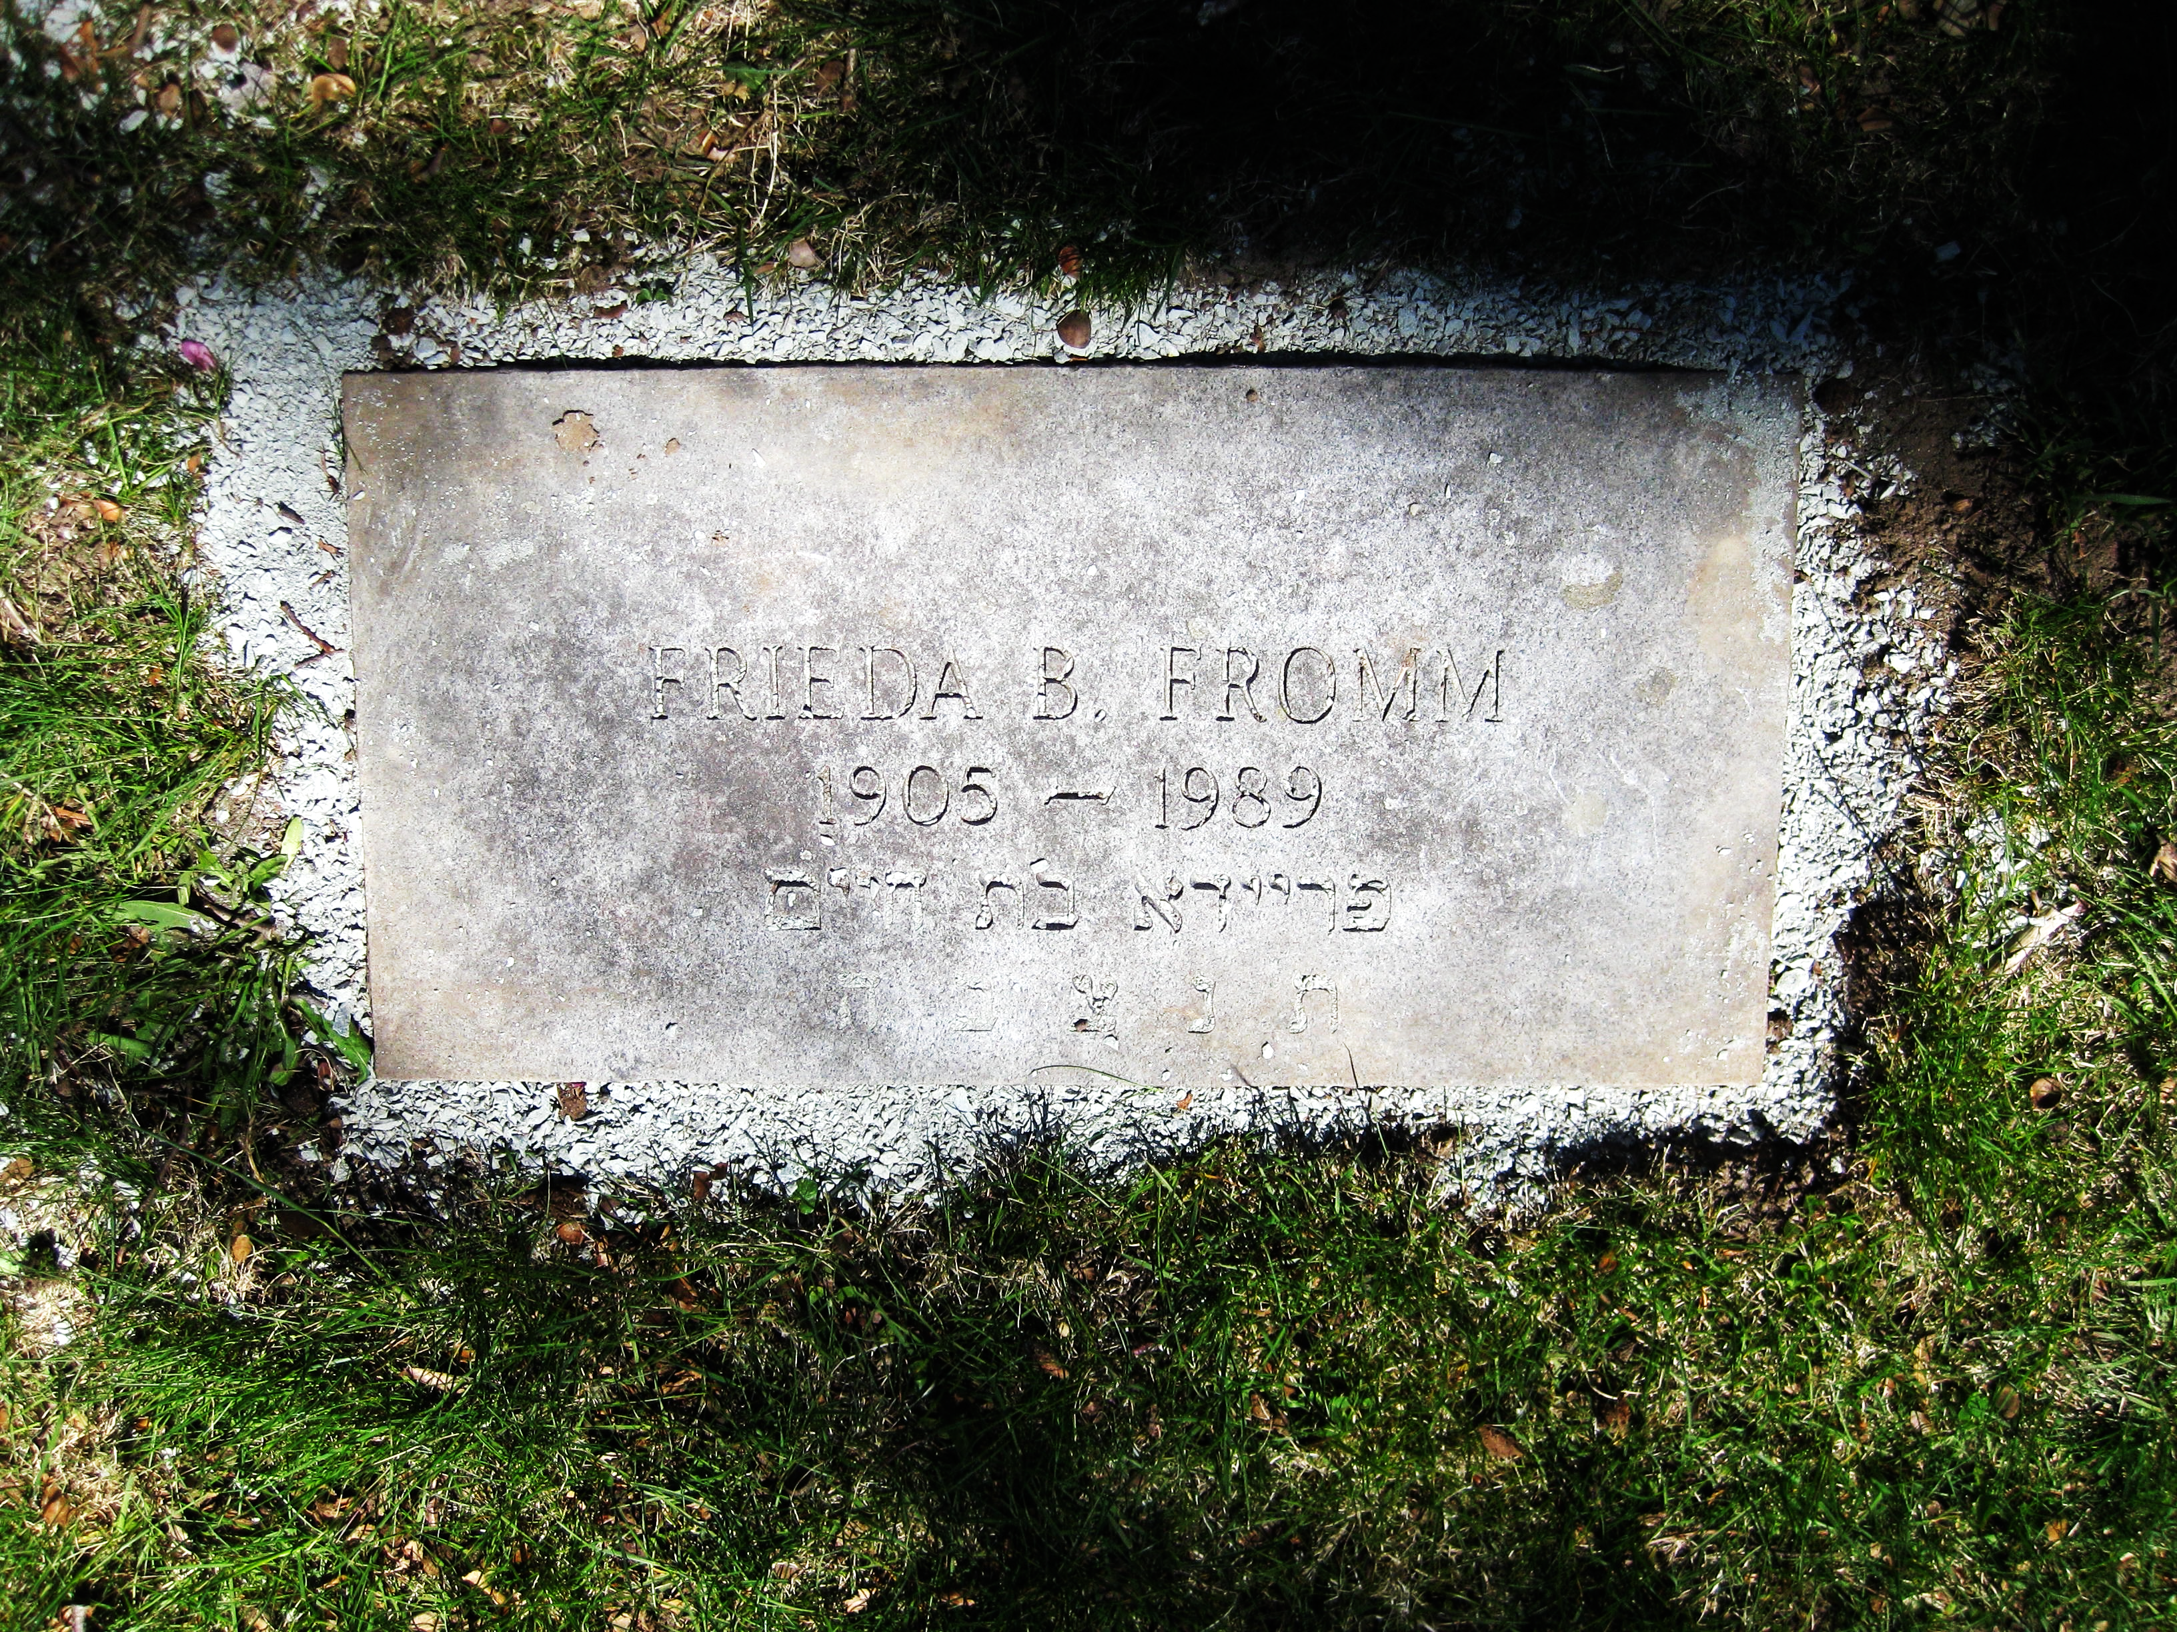
Frieda Fromm (1905-1989)
Frieda From was born in Austria on November 23, 1905. After emigrating to America, she spent some time in New York. By the mid-1930s, living in Norwood, she was employed as an office worker at Codex Book Company on Broadway. She worked there for more than 50 years. Never married, she lived first in a rooming house at 767 Washington Street and later, had a small apartment in the Talbot Block at 738 Washington Street. A valued member of the Temple Shaare Tefilah and the sisterhood of the Friendship Club of the Temple, Fromm was a volunteer at the Norwood Hospital for decades. After her retirement in 1980, she also volunteered and visited with residents of Norwood’s nursing homes, including the Ellis, Maple Grove, and Charlwell House. She became close to the Hershman family. Max and Mollie Hershman became her guardians. She died on March 22, 1989 at the Ellis Nursing Center and is buried with the Hershmans in Highland Cemetery.

Slide 34
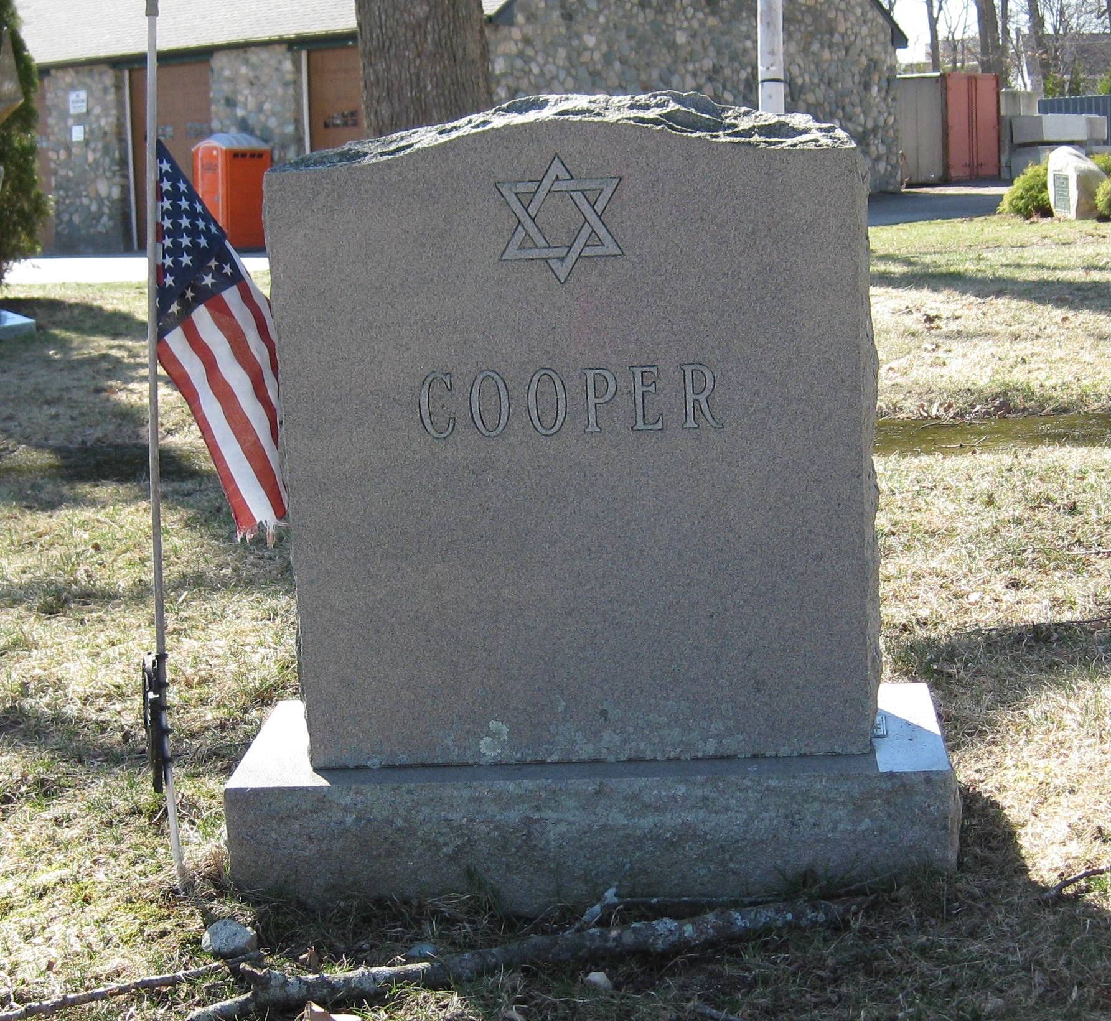
Lot #917
Otis Cooper (1911-1968)
Otis Cooper was born in Chelsea, Massachusetts on April 9, 1911, and attended Winthrop Schools. He came to Norwood with his father around 1928 with his father, Jacob. Together they founded Town Square Hardware & Supply Company. Otis graduated from Tufts University in 1932. He returned to Norwood, married his wife, Yetta, and raised his family. He was an Army veteran of World War II in the European theatre. Very involved in the community, he served as president of the Norwood Rotary Club, the Norwood Hebrew Congregation, and the Neponset Valley Tufts Club. He was also an officer in the Friends of Morrill Memorial Library organization and a founder of Norwood Little League. Cooper closed his store in June of 1968 and accepted a position as general manager of Master Hardware Distributors. He was on a business trip in Chicago when he died of a heart attack on July 15, 1968. He was 57 years old. He was survived by his father, Jacob, his wife, Yetta, and two children, Marianne Cooper Weill of New York City, and Bernie Cooper of Norwood.

Slide 35
Prominent Families in Early Norwood at Highland Cemetery
Winslow and Smith Tannery
George Winslow (near Winslow tomb)
Francis O. Winslow, son of George Winslow (tomb in section # 11)
Lyman Smith (lot #403)
John Smith, son of Lyman (tomb in section #5)
In 1776 the tanning and manufacture of raw hides into leather began in the South Parish with Abner Guild’s tannery on Hawes Brook, near today’s Endicott Street. By 1831, this original business had passed into the hands of Lyman Smith and George Winslow. These brothers-in-law continued as partners until 1853 when the firm was dissolved and each established a distinct family business of his own. George Winslow and his sons, Elisha, George, Martin, and Francis, continued the tanning of sheep and calfskin at the original location under the name George Winslow & Sons. When the elder Winslow retired in 1860, the business was carried on under the name of Winslow Brothers. Meanwhile, Lyman Smith and his sons, Charles and John, built a new tannery beside the railroad tracks at the northern end of town, near the Old Parish Cemetery.
By 1890, both establishments had grown to the point where each employed more than 150 men and were processing over one million hides annually. The Smith tannery, which had changed its name to Lyman Smith’s Sons in 1856, when the elder Smith retired, had refined the manufacture of lamb and sheep leather and had grown from a single wooden building to a facility covering more than an acre of prime real estate. By the late 1890s, Winslow Brothers, with the addition of wool pulling and scouring activities, had increased its workforce to 275 as its primary products became law book leather, linings for the shoe and boot trades, and sheep leather. George Willett brought about the re-consolidation of the two tanneries in 1901.
Francis O. Winslow was one of the Winslow Brothers who owned the Winslow Brothers tannery and was a State Representative and president of the Norwood Co-operative Bank. The last surviving original town official, Winslow was often called upon to recount events surrounding the community’s origins.

Slide 36
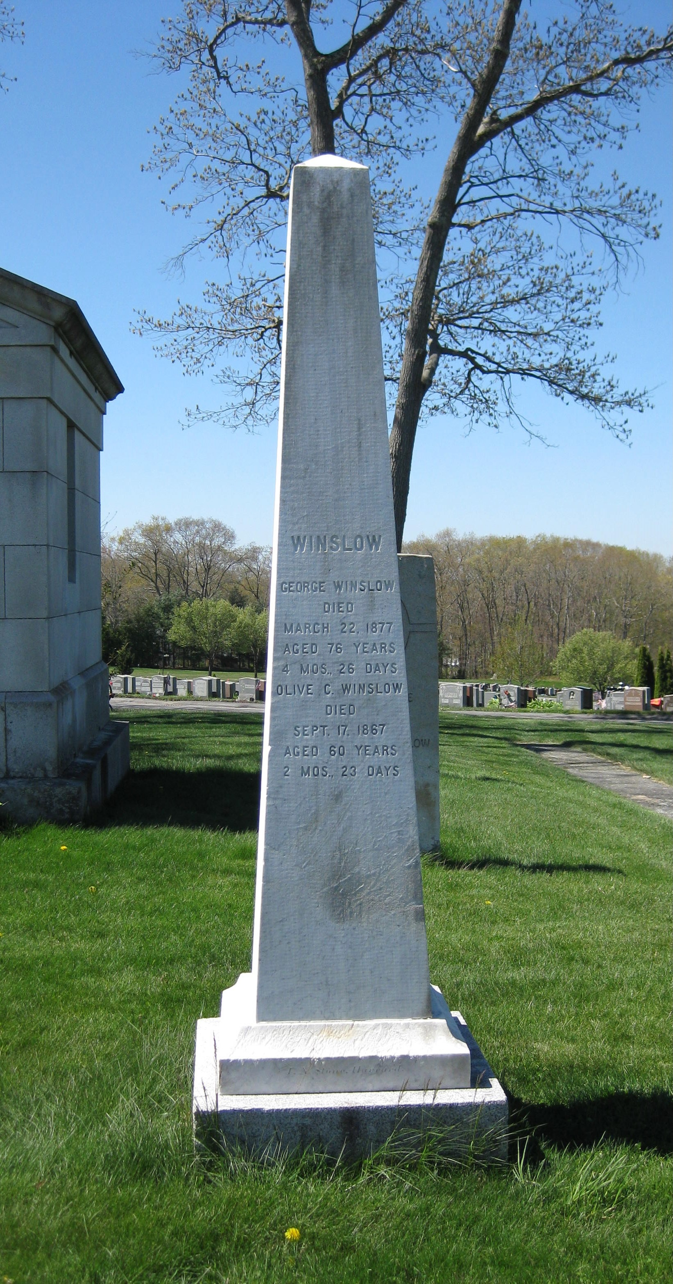
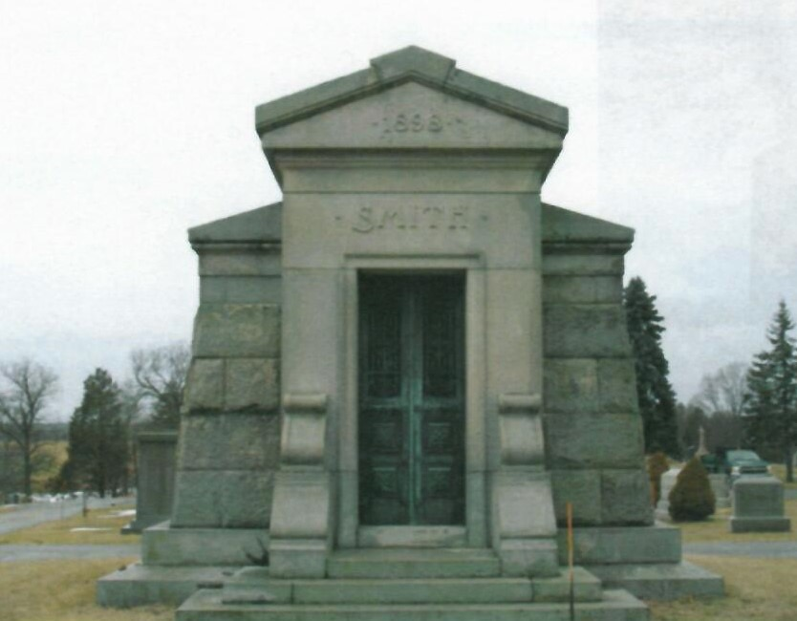
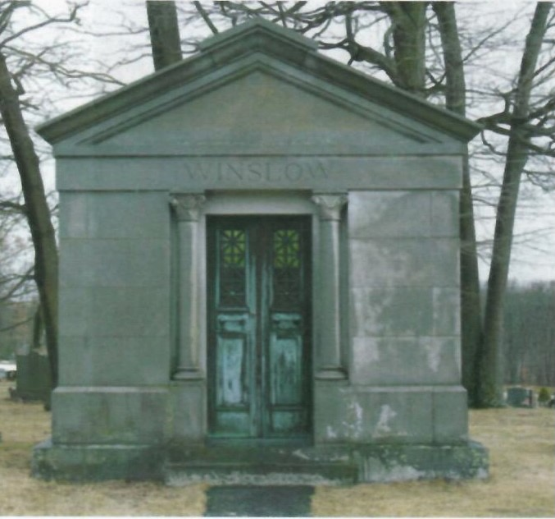
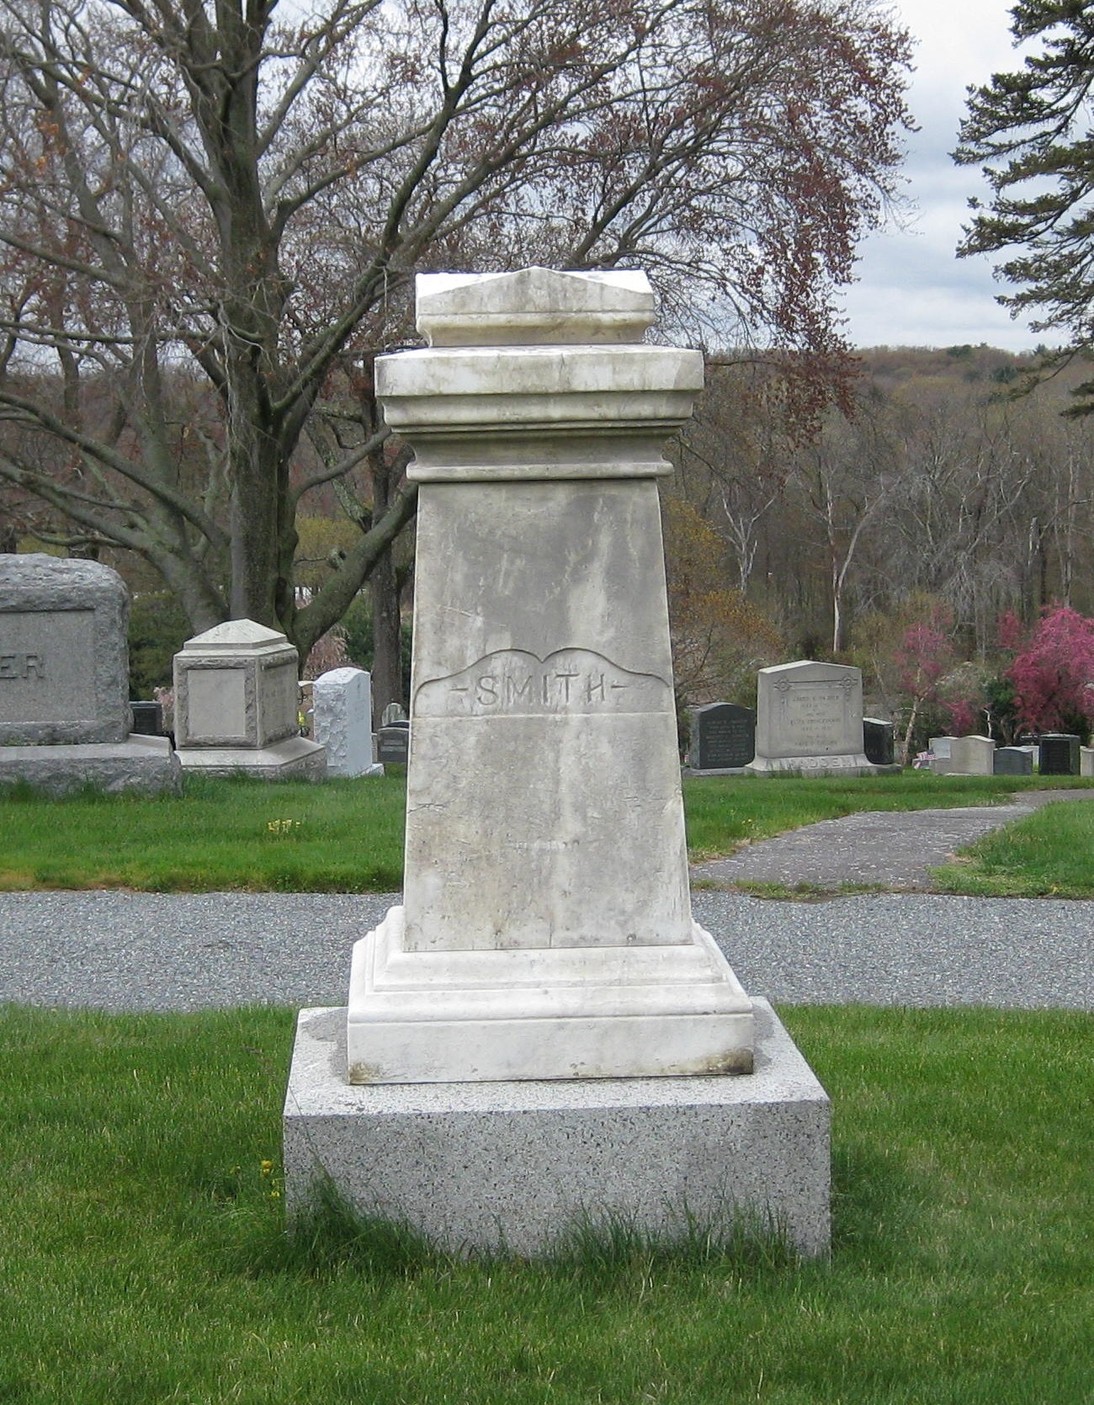
Smith Mausoleum
F. O. Winslow Tomb
George & Olive Winslow
Lyman Smith

Slide 37
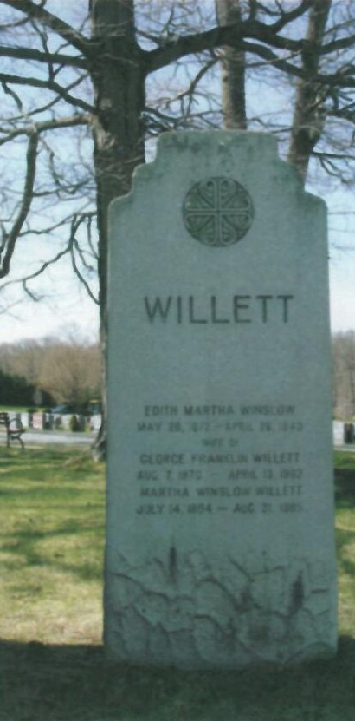
George F. Willett (near F. O. Winslow tomb)
Born on August 7, 1870 in Walpole, Massachusetts, where his ancestors had settled some two hundred years before, George Willett grew to have, as one historian put it, “a greater impact upon the development of the town of Norwood than any other individual in the course of its history.” He spent his early life in Walpole, attended public schools and, later, studied industrial chemistry at Boston University. He entered the wool business in Boston and, along with his partner, Edmund H. Sears, formed a holding company that operated a chain of various industries for the manufacture of carpets, shoes, felt and other related products. Willett quickly amassed a fortune and Willett Sears & Company became known for the successful reorganization and management of industrial concerns.
In 1893, Willett married Edith Winslow, daughter of F. O. Winslow, built a home near his in-laws, and became involved in the operation of the tannery. By 1895, he acquired controlling interest in Winslow Brothers. Two years later he purchased the second family-owned tannery in town, Lyman Smith’s Sons. In 1901 he merged the two firms into Winslow Brothers & Smith, thereby reconsolidating what George Winslow and Lyman Smith had divided in 1853 and bringing Norwood’s tannery history full circle. In 1914, spearheaded by Willett and other reformers, Norwood became the first town in New England and only the twelfth in the country to adopt the town manager form of government, placing the day-to-day business of the community in the hands of a management professional. Willett’s plans for Norwood went far beyond municipal reform, however, and ultimately resulted in a civic association, a housing association, a bank, a hospital, the revamping of the entire downtown business district.

Slide 38
Governor Frank G. Allen (corner lot, left of F. O. Winslow tomb)Born in 1874 in Lynn, Massachusetts to working class parents. Allen entered the executive offices with the Winslow Brothers and Smith Company in 1893, eventually rising to the positions of President and Chairman of the Board from 1912 to 1929. In 1897, he was married to Clara Winslow.
Allen began his political career in Norwood, serving as chairman of the Board of Assessors from 1911 until 1915 and on the Board of Selectmen from 1915 to 1924. In 1918 and 1919, he was a member of the Massachusetts House of Representatives where he was particularly active on taxation and financial issues and the Special Commission on Street Railways. His term in the House was followed by election to the Massachusetts State Senate in 1920 until 1924. Allen was elected to two terms as Lieutenant Governor in 1924 and 1926. In 1928, as the Republican Party’s nominee, Frank G. Allen was elected Governor of the Commonwealth of Massachusetts and served one term. As Governor, he was known for his honest dealing, his reduction of the debt, and a public welfare program inaugurated to aid handicapped children. He was also one of the first to recognize an impending economic crisis and created the Massachusetts Emergency Commission on Unemployment.
Upon retiring in 1930, Allen returned as chairman of the Board of Directors at Winslow Brothers & Smith Company. He also held several other trustee and directorship positions with Atlantic Mutual Indemnity Company, Boston Chamber of Commerce, Boston University, Boston & Providence Railroad Company, John Hancock Mutual Life Insurance Company, and others. He continued to serve the local community as a director of the Norwood Co-operative Bank and trustee of the Norwood Hospital. In 1944, Frank Allen, still chairman of the board of directors of the tannery, ended his 48-year residence in Norwood, moving to Boston’s Back Bay. In December of 1947, Allen retired as chairman of the board of Winslow Brothers & Smith Company, and, in October, 1950, at the age of 76, he died at his Boston home.

Slide 39
Allen Memorial

Slide 40
Morrill Ink Works
George H. Morrill Family (lot #108, 109) and Shattuck Family (lot #110)
In 1856, Samuel Morrill, a printer, publisher, and manufacturer of printing inks, moved his business from Andover, Massachusetts to South Dedham. Along with his sons, George H., and Samuel S., the elder Morrill concentrated on the development of superior printing inks. In 1869, when the original firm was reorganized under the name George H. Morrill and Company, it was already recognized as an important force in the industry. Morrill’s grew so fast that by 1884 the plant had expanded from one small structure on Pleasant Street to fourteen wooden and brick buildings. In that same year, George H. Morrill, Jr., and his brother-in-law, Edmund Shattuck, joined the firm and, along with George H. Morrill, made the company a world-wide success.
Although the manufacture of colored inks commenced in Norwood in 1905, the company’s specialty continued to be perfecting-press ink which was used in the majority of newspaper offices across the country. With close to one hundred employees at the Norwood plant, branch stores and factories were established in Los Angeles, Chicago, New York, Philadelphia, San Francisco, and London, England, with a distributing plant in Toronto, Canada. Modifying its name once again in 1909 to the George H. Morrill Company, the enterprise continued to expand, spreading along a vast expanse of Pleasant Street, near the New York, New Haven and Hartford Railroad station known simply as Morrills. With company-managed facilities supplying necessary raw materials and products, by 1913, it was considered the largest printing ink works in the world, exporting to Europe, Australia, and Japan.
Through the generosity of Mr. and Mrs. George H. Morrill, the building of the Morrill Memorial Library took place. In 1897, grieving from the loss of their 23-year-old daughter to typhoid fever in 1896, George H. and Louisa J. Morrill saw the library as a way to establish a permanent memorial to her. The town accepted this magnanimous philanthropic gesture and, a Romanesque Revival style structure, a near duplicate to the Lithgow Library in Augusta, Maine, was erected. In February of 1898, the Sarah Bond Morrill Memorial Library was dedicated.

Slide 41
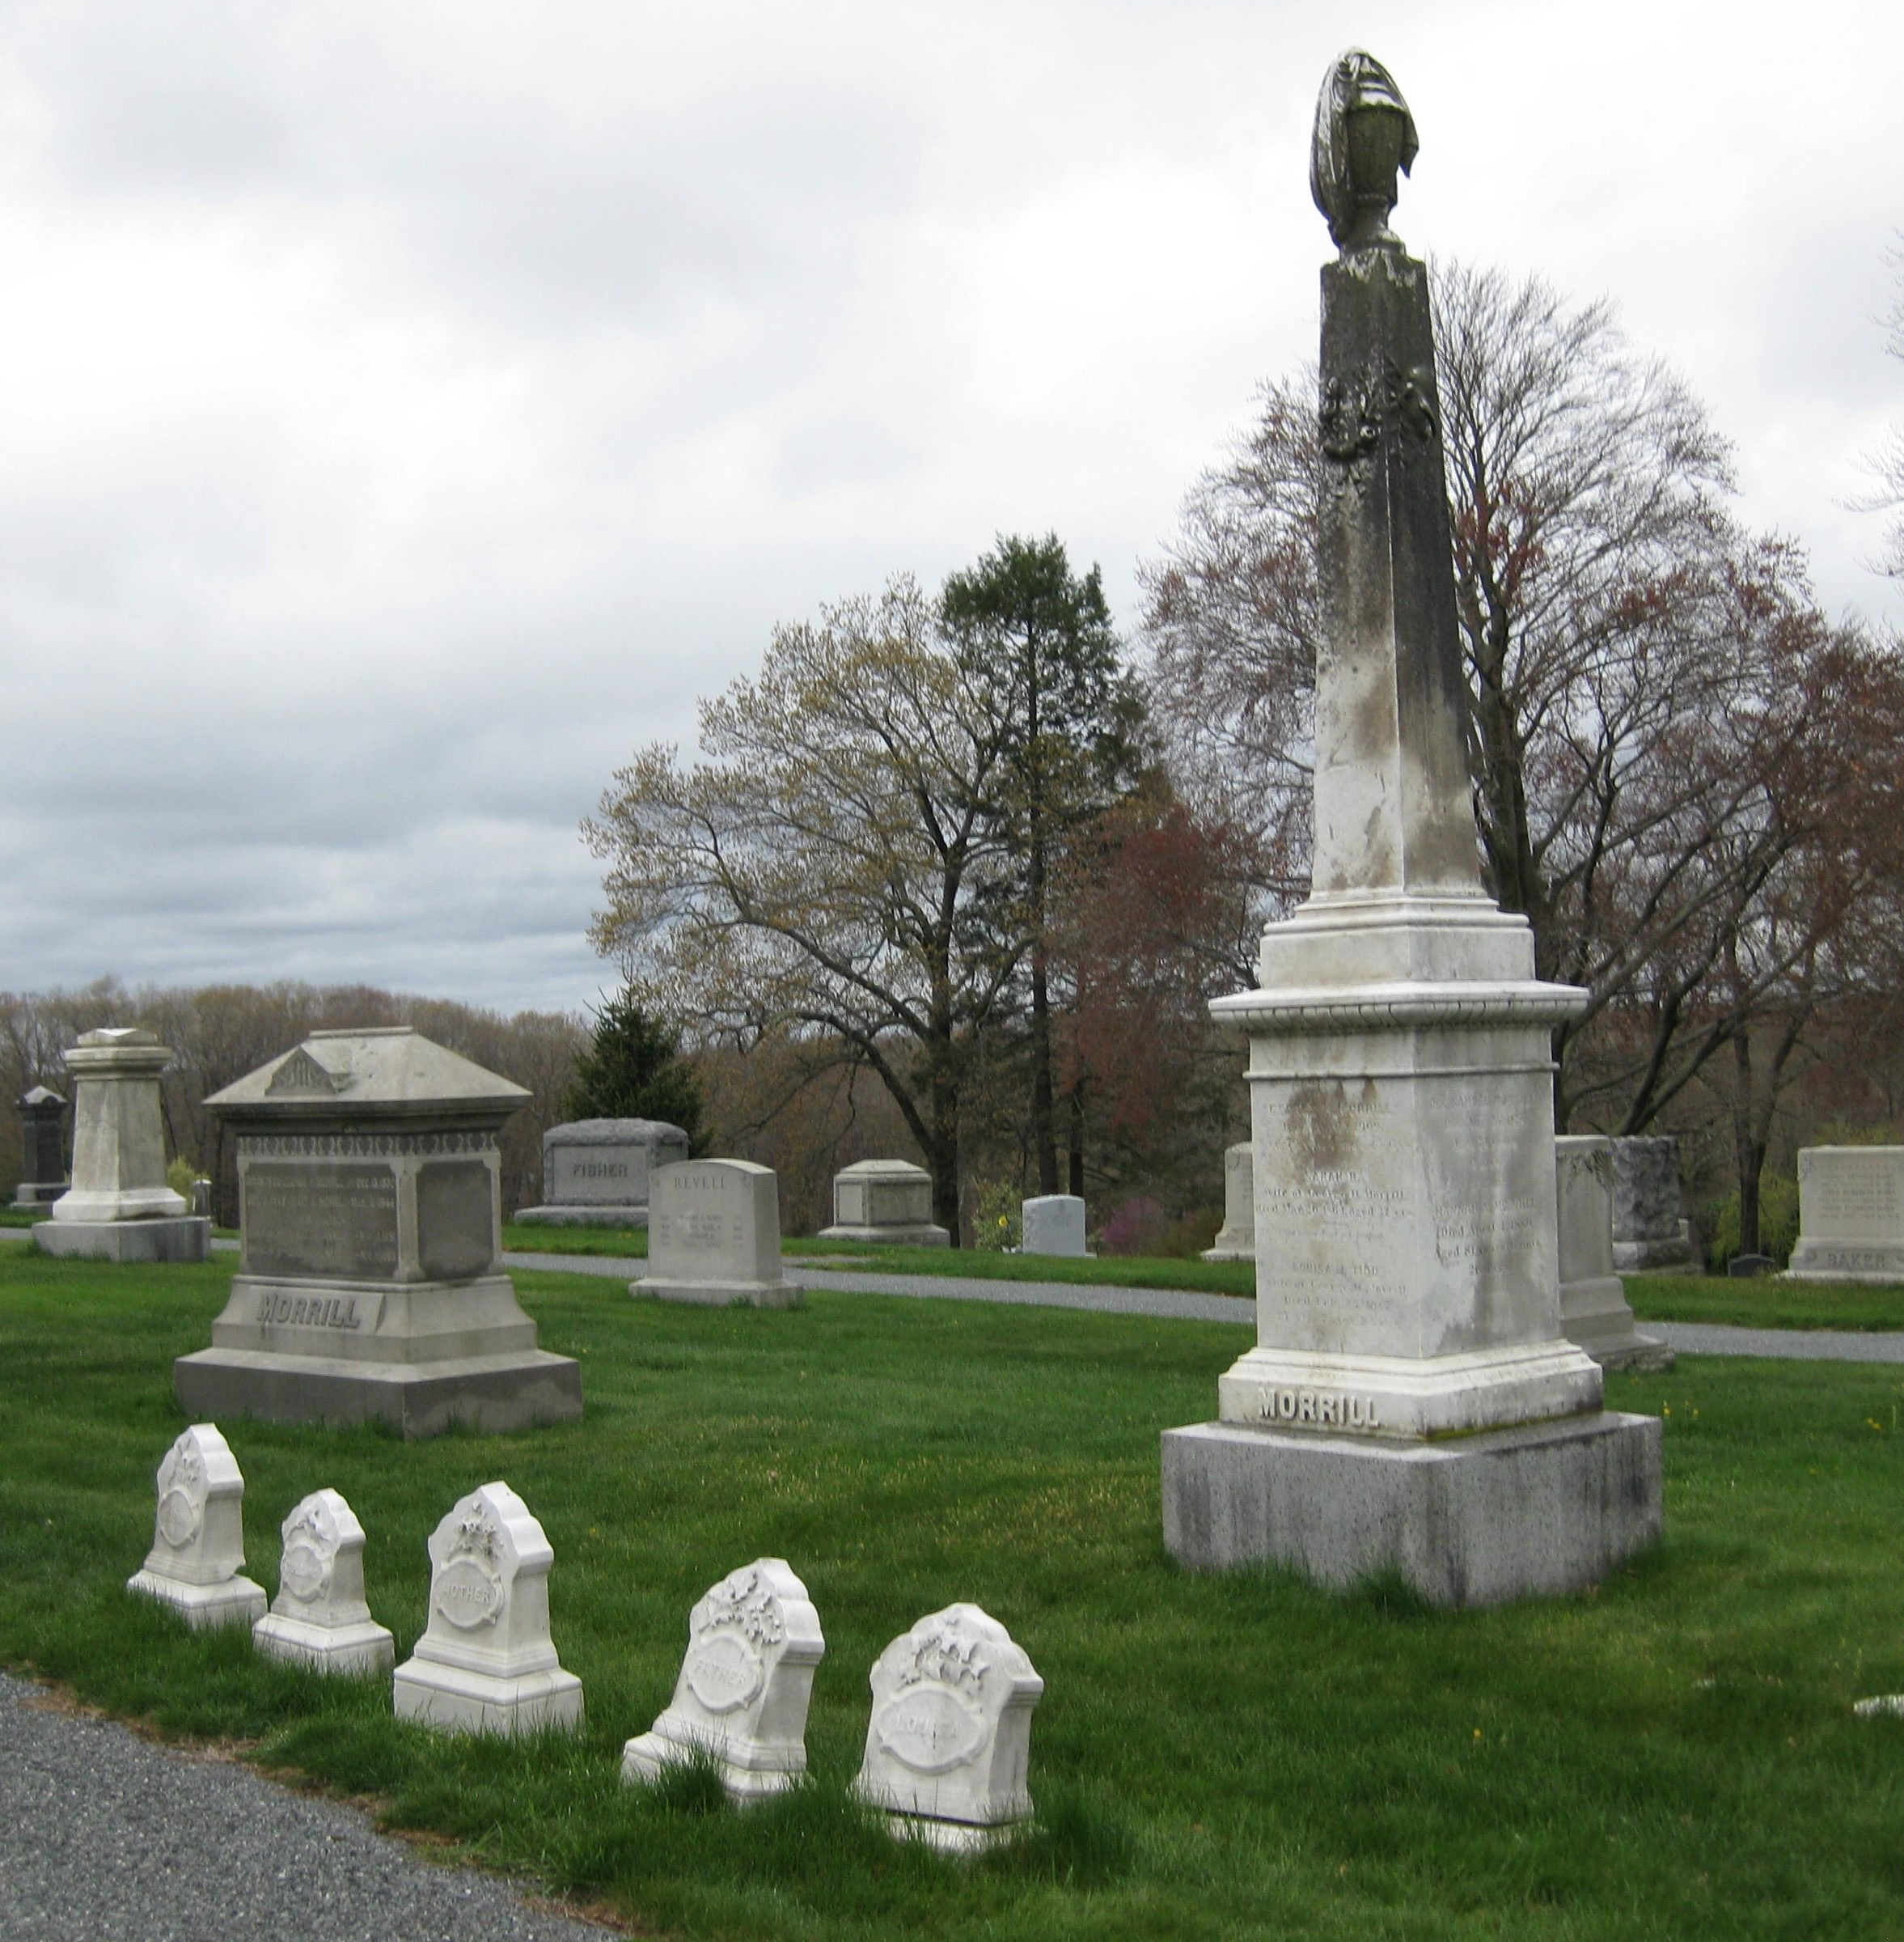
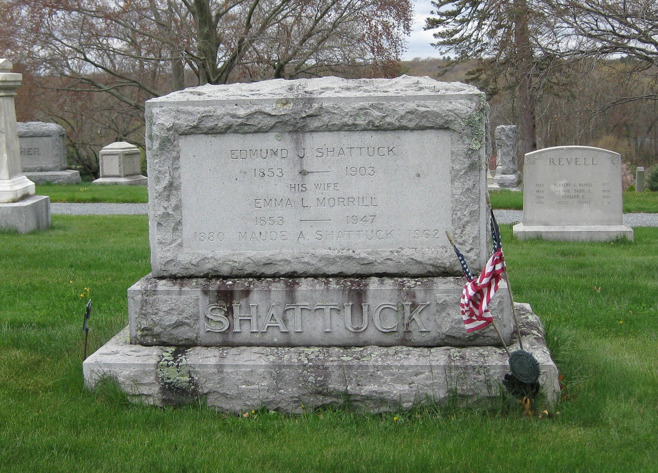
Shattuck Family
George H. Morrill Family

Slide 42
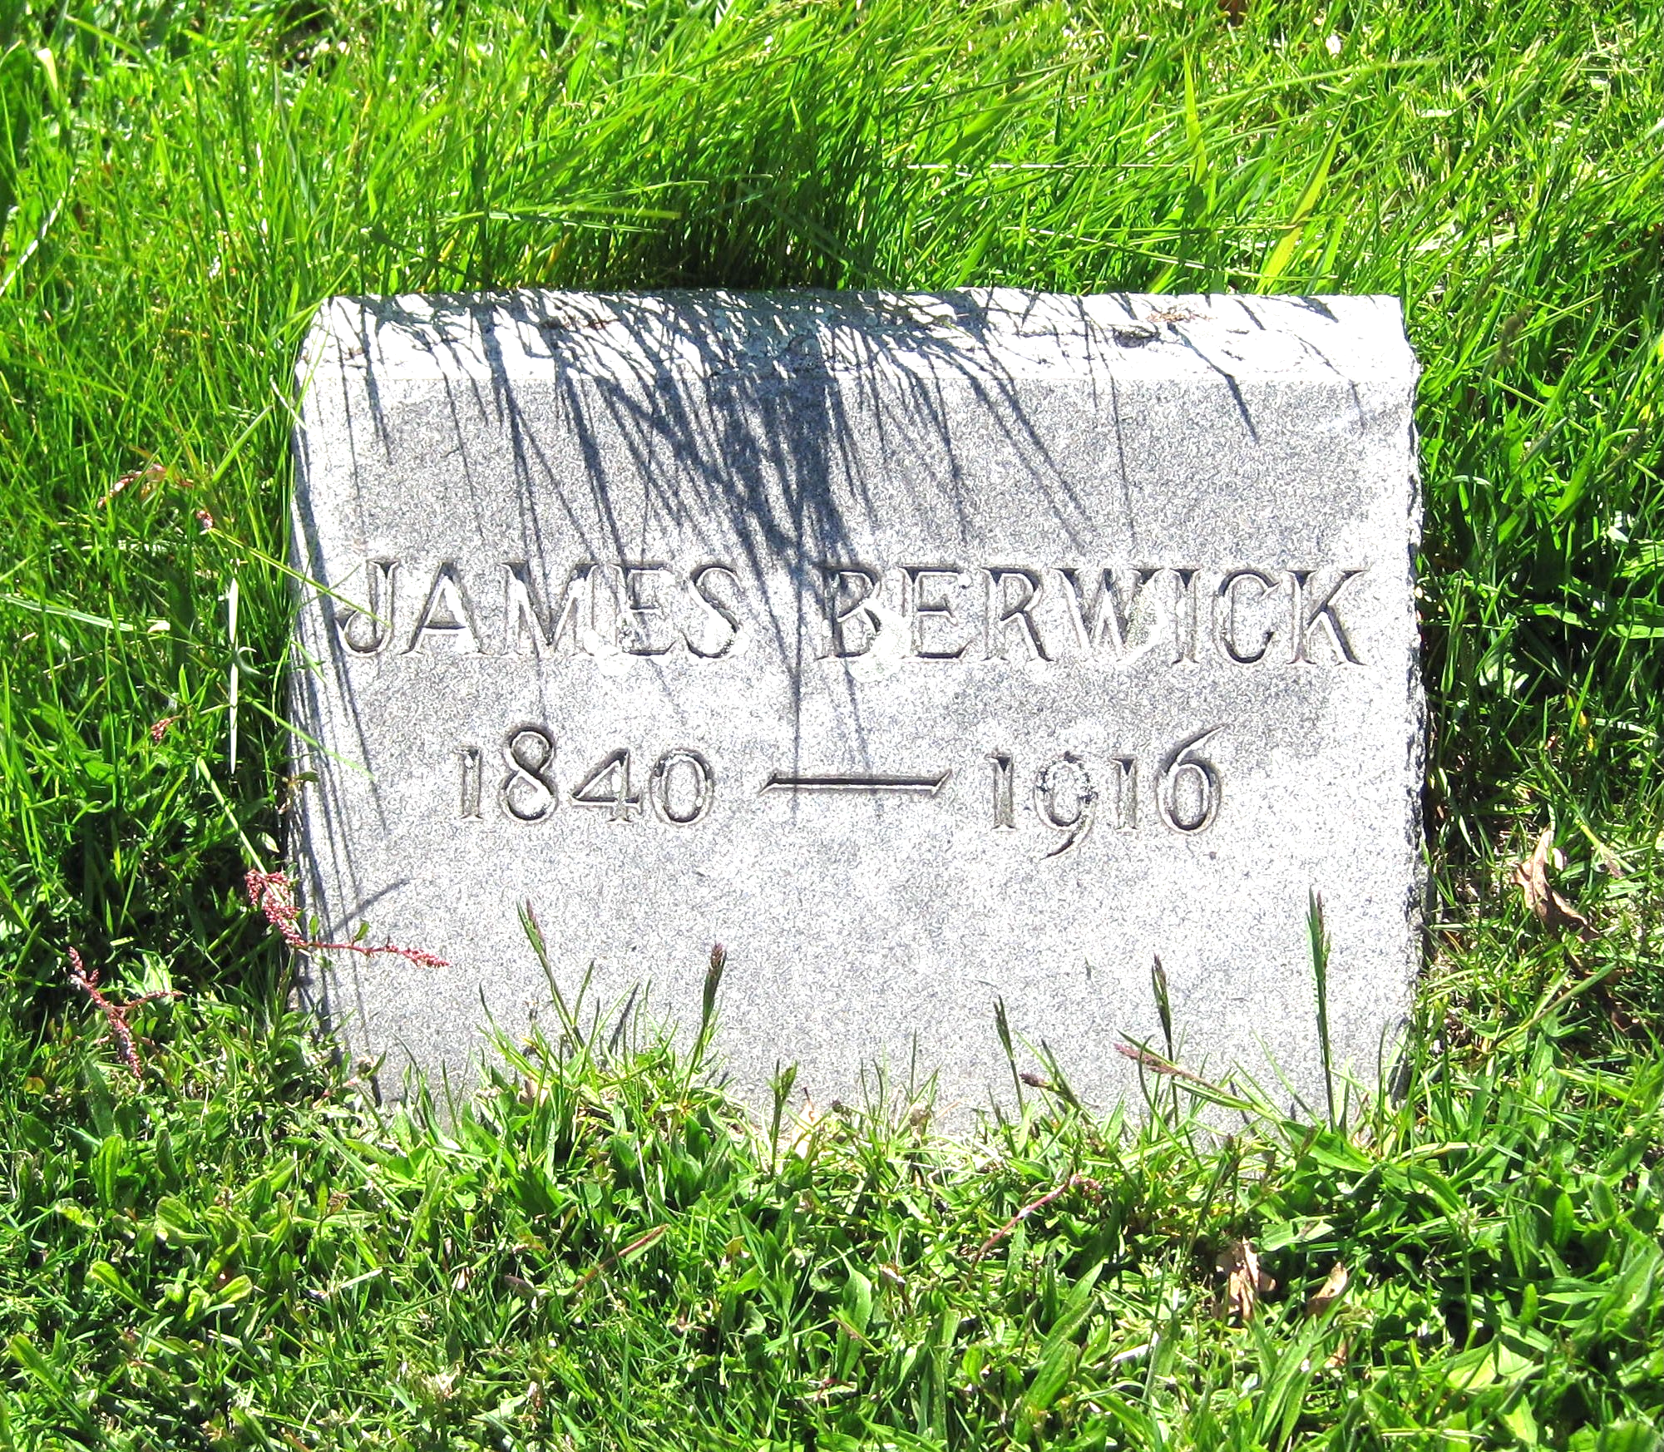
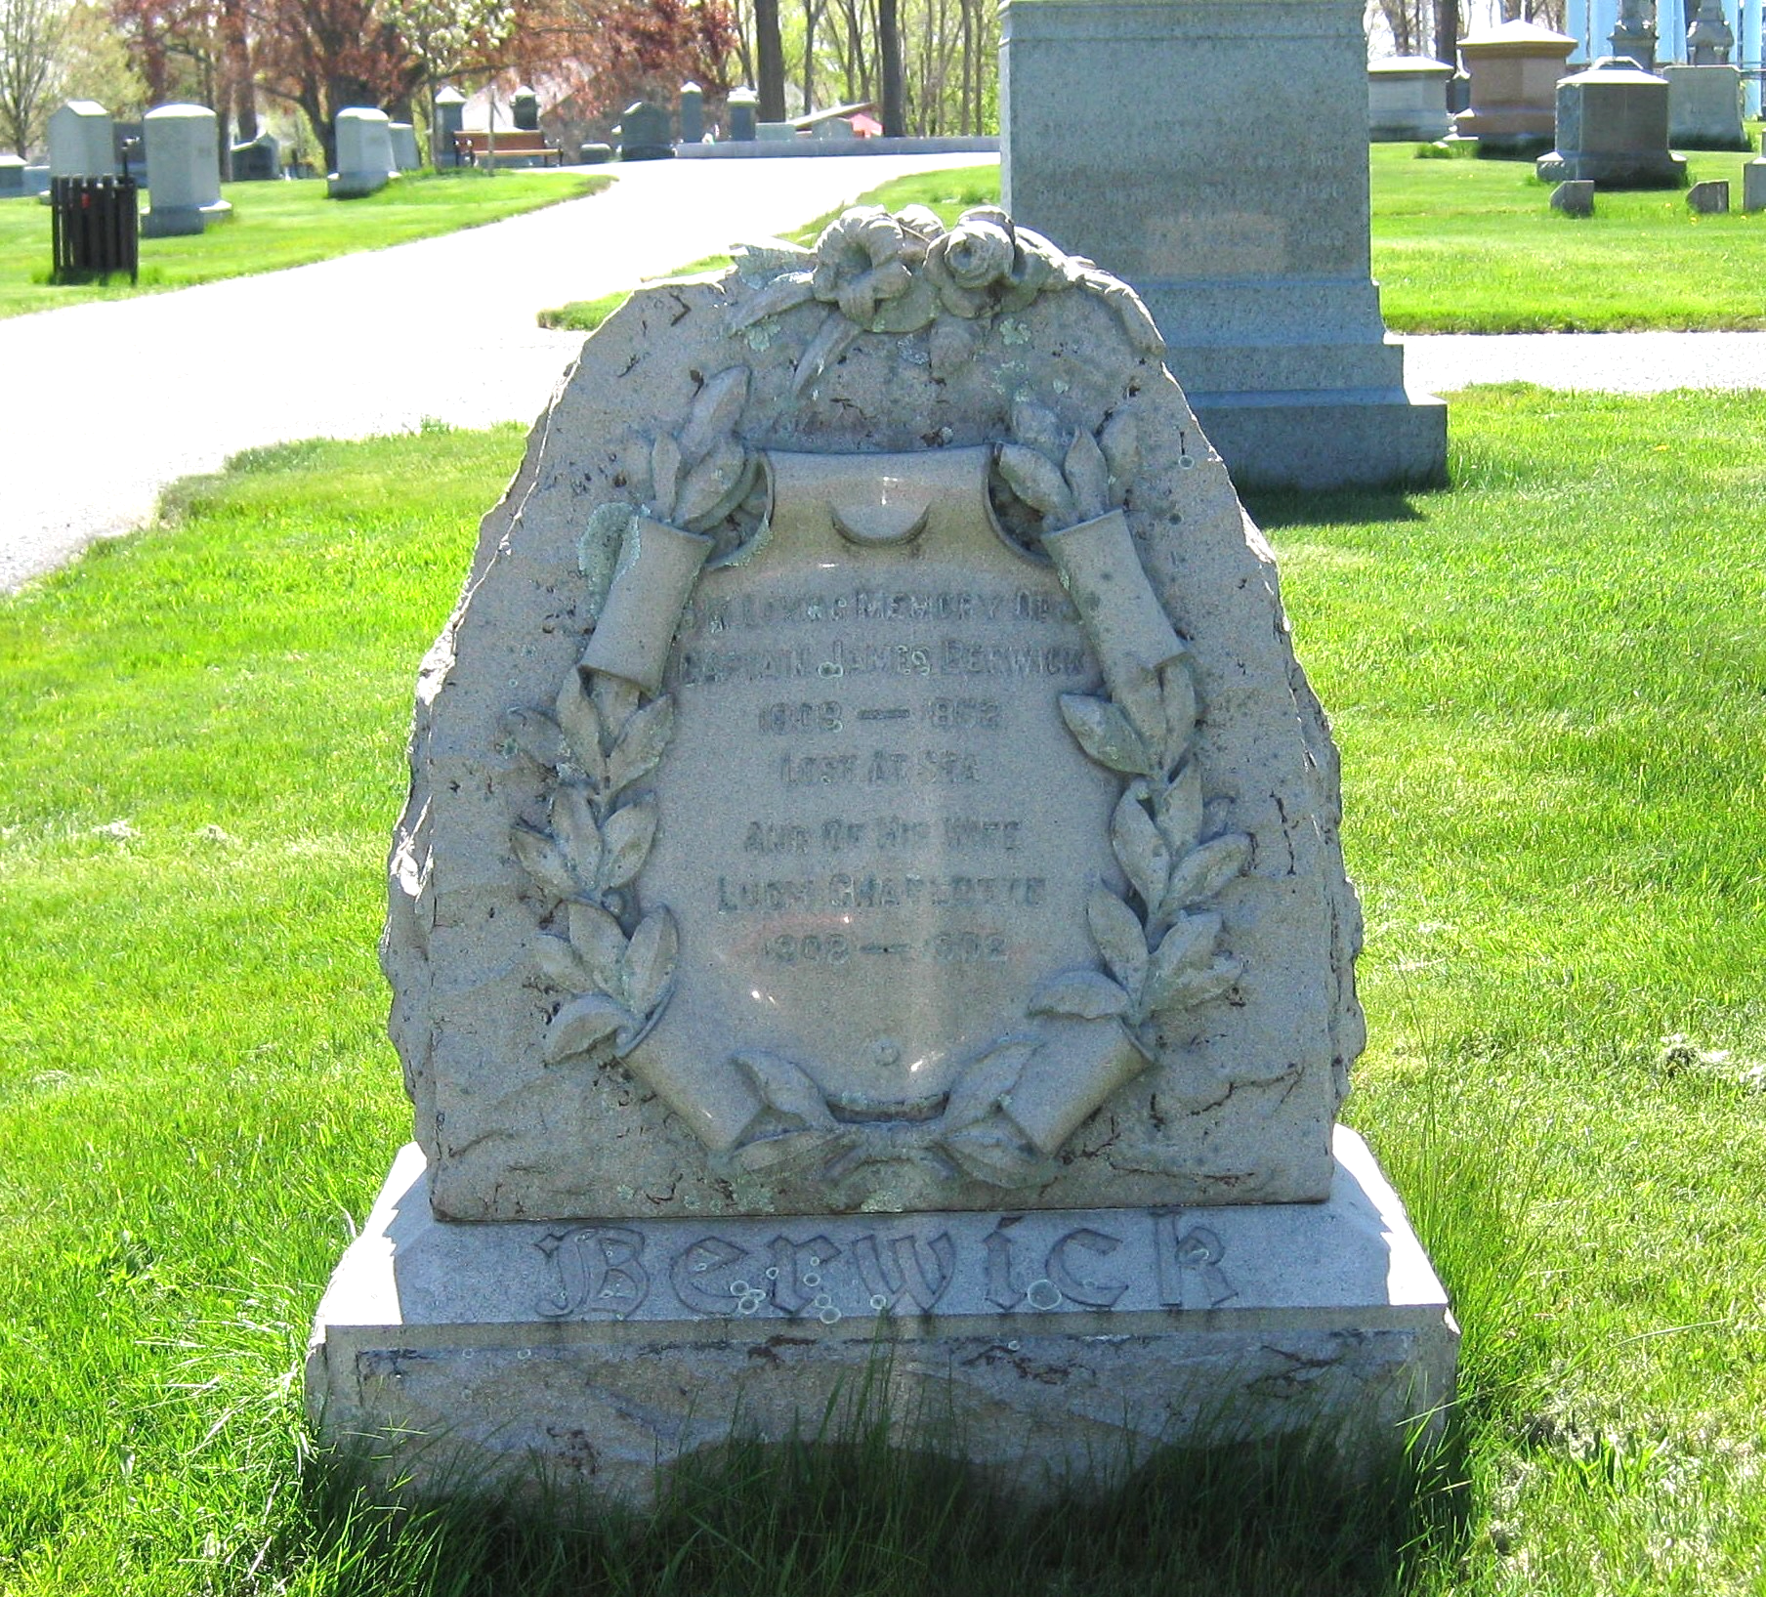
Norwood Press
J.Stearns Cushing (section #13) and James Berwick (lot #396)
One of the first achievements of the Norwood Business Association, later called the Norwood Board of Trade, established in 1894, was to bring to town the three independent firms -- J. S. Cushing & Company, Berwick & Smith Company, and E. Fleming Company -- who, together formed the Norwood Press. Attracted by the Business Association’s offer of free land and other inducements, J. S. Cushing & Company moved its composition room and electrotype foundry from Boston in 1894. Since its inception in 1878, the business had been under the watchful eye of its sole proprietor, J. Stearns Cushing, who had made high-grade school textbooks his specialty. Berwick & Smith Company, which operated one of the largest press rooms in the country, arrived in 1895. Having been associated with J. S. Cushing since its founding in 1884, this enterprise was headed by James Berwick and George Harding Smith. A branch of the E. Fleming Company of Boston joined these two concerns in a series of strikingly handsome brick buildings at the intersection of Washington Street and Walnut Avenue in 1897. Later changing its name to C. B. Fleming & Company, Inc., when Charles B. Fleming, grandson of the founder, took over management, this was a press bindery. The addition of this business to the Norwood Press enabled all processes of bookmaking from start to finish to be completed in one large interconnected plant.
While each of the firms maintained their own customer list and separate production orders, a great deal of their collective business derived from complete book fabrication. The Norwood Press specialized in scientific, school and college textbooks, Bibles, illustrated books, catalogues, and pamphlets. Collectively the conglomerate employed some 700 workers during the first two decades of the 20th century. In 1929, J. S. Cushing & Company added facilities geared to the publication of more popular, less seasonal, works of fiction and biography, which, for a time, stabilized the enterprise during and after the Depression. At its peak, the Norwood Press was one of the largest conglomerates of its kind in the country and was widely recognized for the quality and speed of its production.

Slide 43
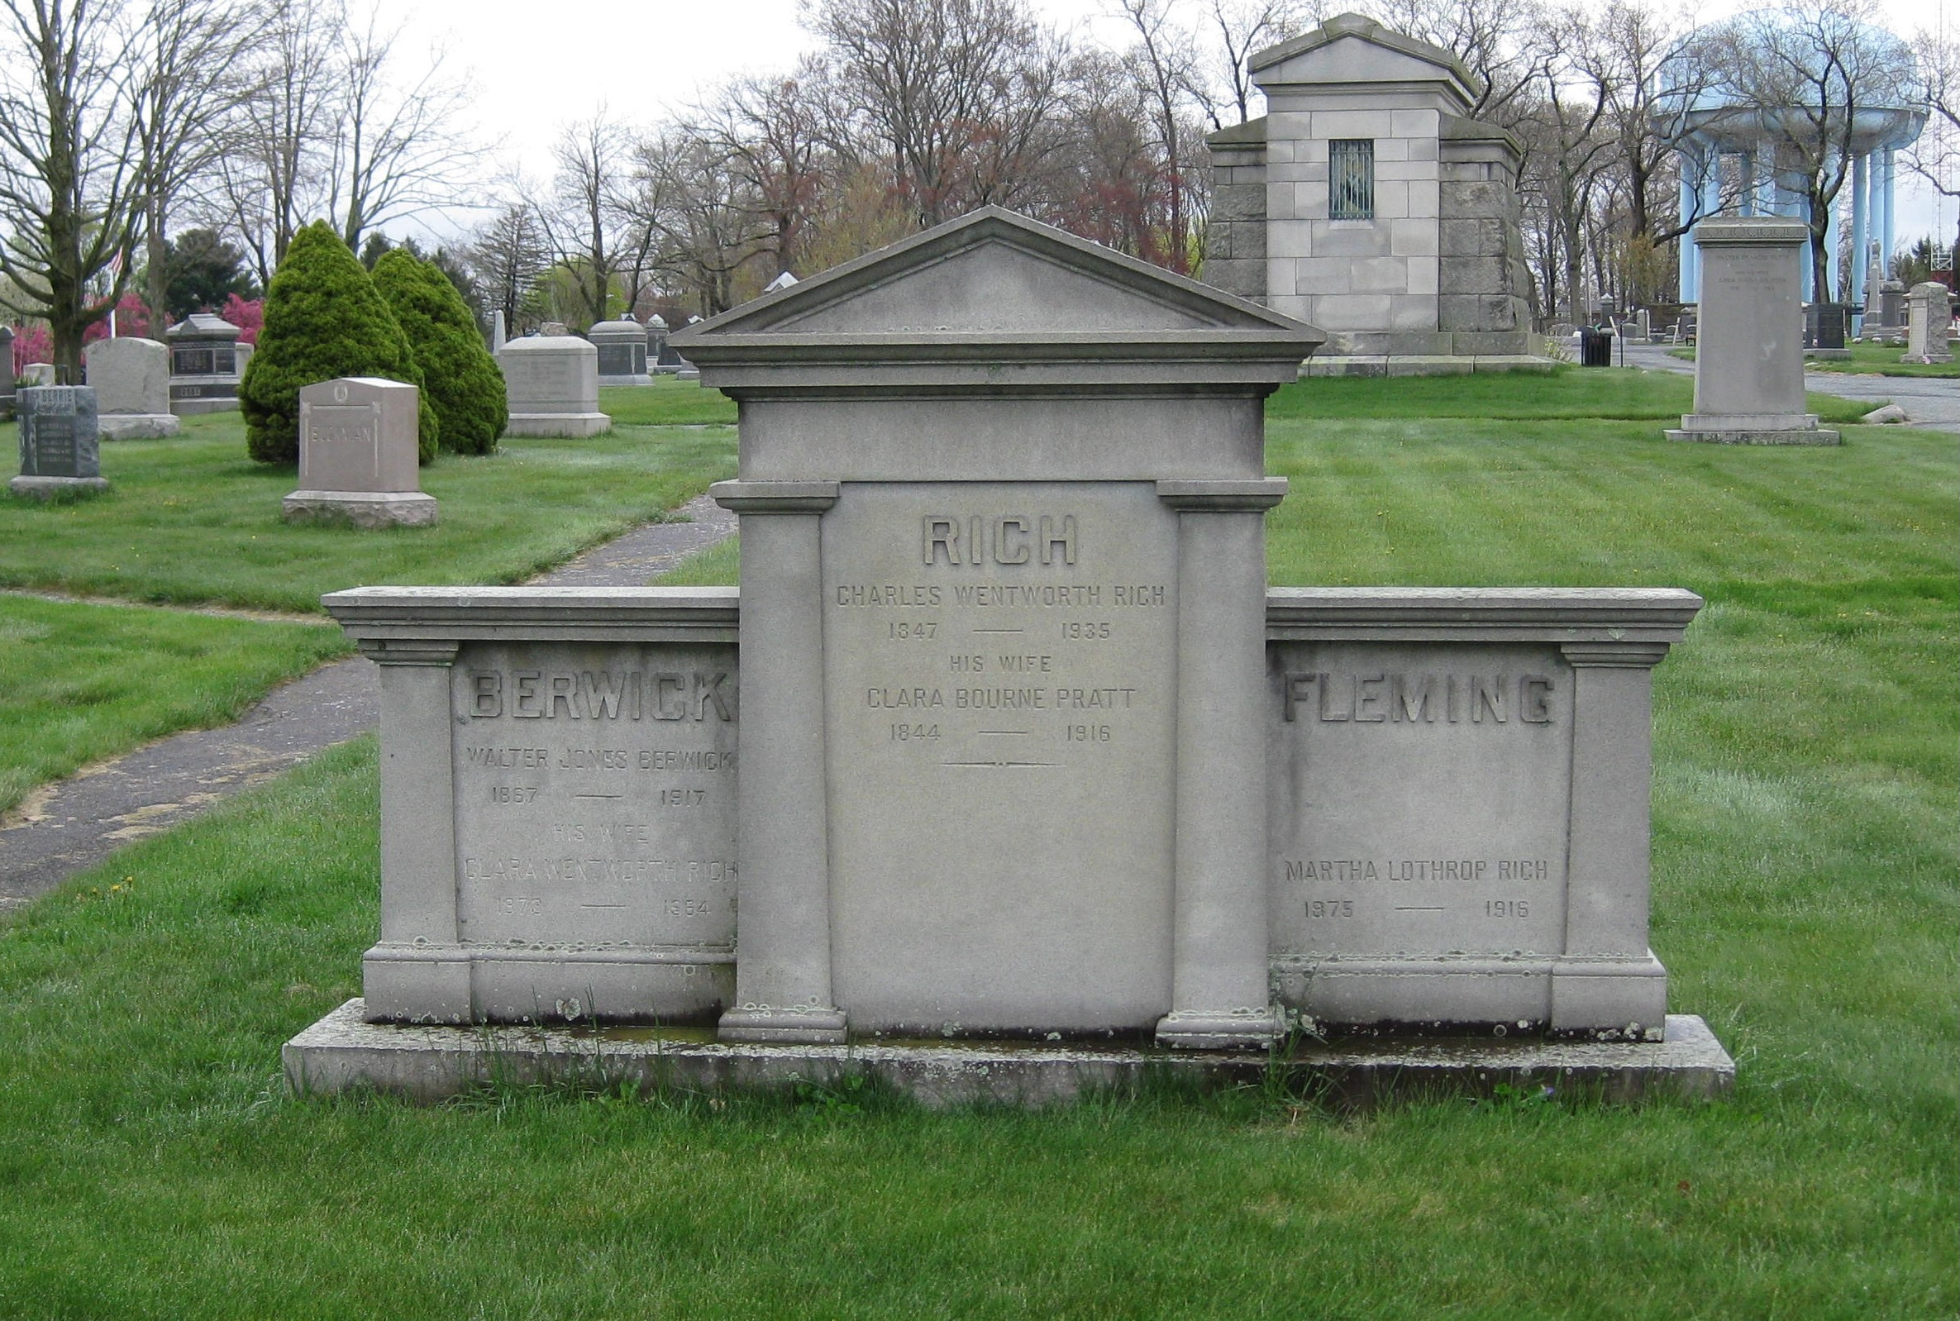
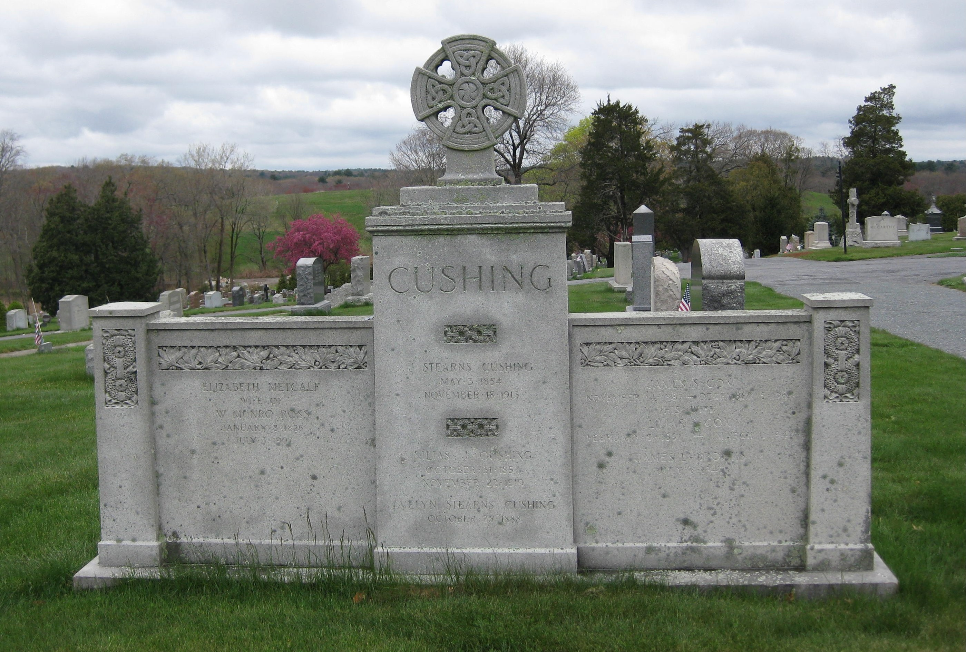
Berwick, Rich, Fleming Memorial
Cushing Memorial

Slide 44
Plimpton Press
Plimpton Family (section #6)
Enhancing Norwood’s reputation as a bookmaking center was the Plimpton Press, an enterprise co-founded by local resident Herbert M. Plimpton and his brother Howard. Born in Walpole, Herbert Plimpton had trained as a compositor, pressman, and binder at a time when bookmaking was largely a process completed by hand labor. In 1882, he founded a book manufacturing company in Boston where he was among the first to advocate for labor and time-saving machinery in the industry. According to several sources, the first folding machines, modern sewing machines, and the first rounding and backing machines were used in Plimpton’s Boston plant. Plimpton Press also used the first cover-making machine and invented the first gathering machine. In 1897, attracted by concessions again offered by the Norwood Business Association, Plimpton moved his press work and binding operations to a site east of the railroad tracks on land bounded by Lenox and Nahatan Streets. In 1904 he brought the remainder of his Boston business to Norwood and, by the next year, the firm, known as H. M. Plimpton & Company, employed about six hundred. In 1913 the business incorporated as the Plimpton Press and, during the 1920s, employed upwards of 1000. Its business derived primarily from textbook publishers across the United States and, at its peak, the Plimpton Press could roll 50,000 volumes off its presses daily. Like the Norwood Press, Plimpton Press added fiction, reference works, and religious books to its production schedule in an attempt to offset the seasonal nature of textbook publishing. While the typesetting, presswork, and binding elements of book production were completed in the Plimpton plant, the fabrication of book cloth and binding material was the work of Holliston Mills. By 1960 active manufacturing had ceased in Norwood and, a decade later, only the executive offices remained in town.

Slide 45
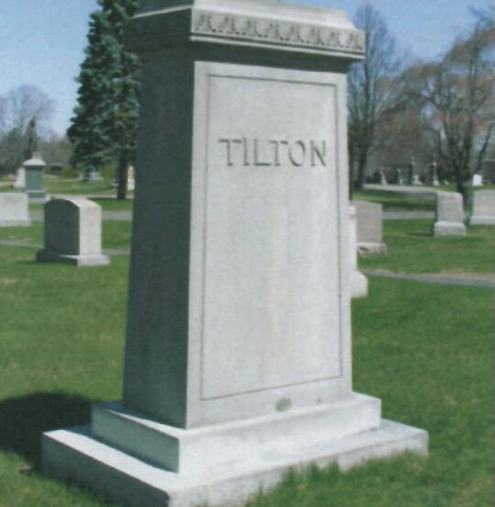
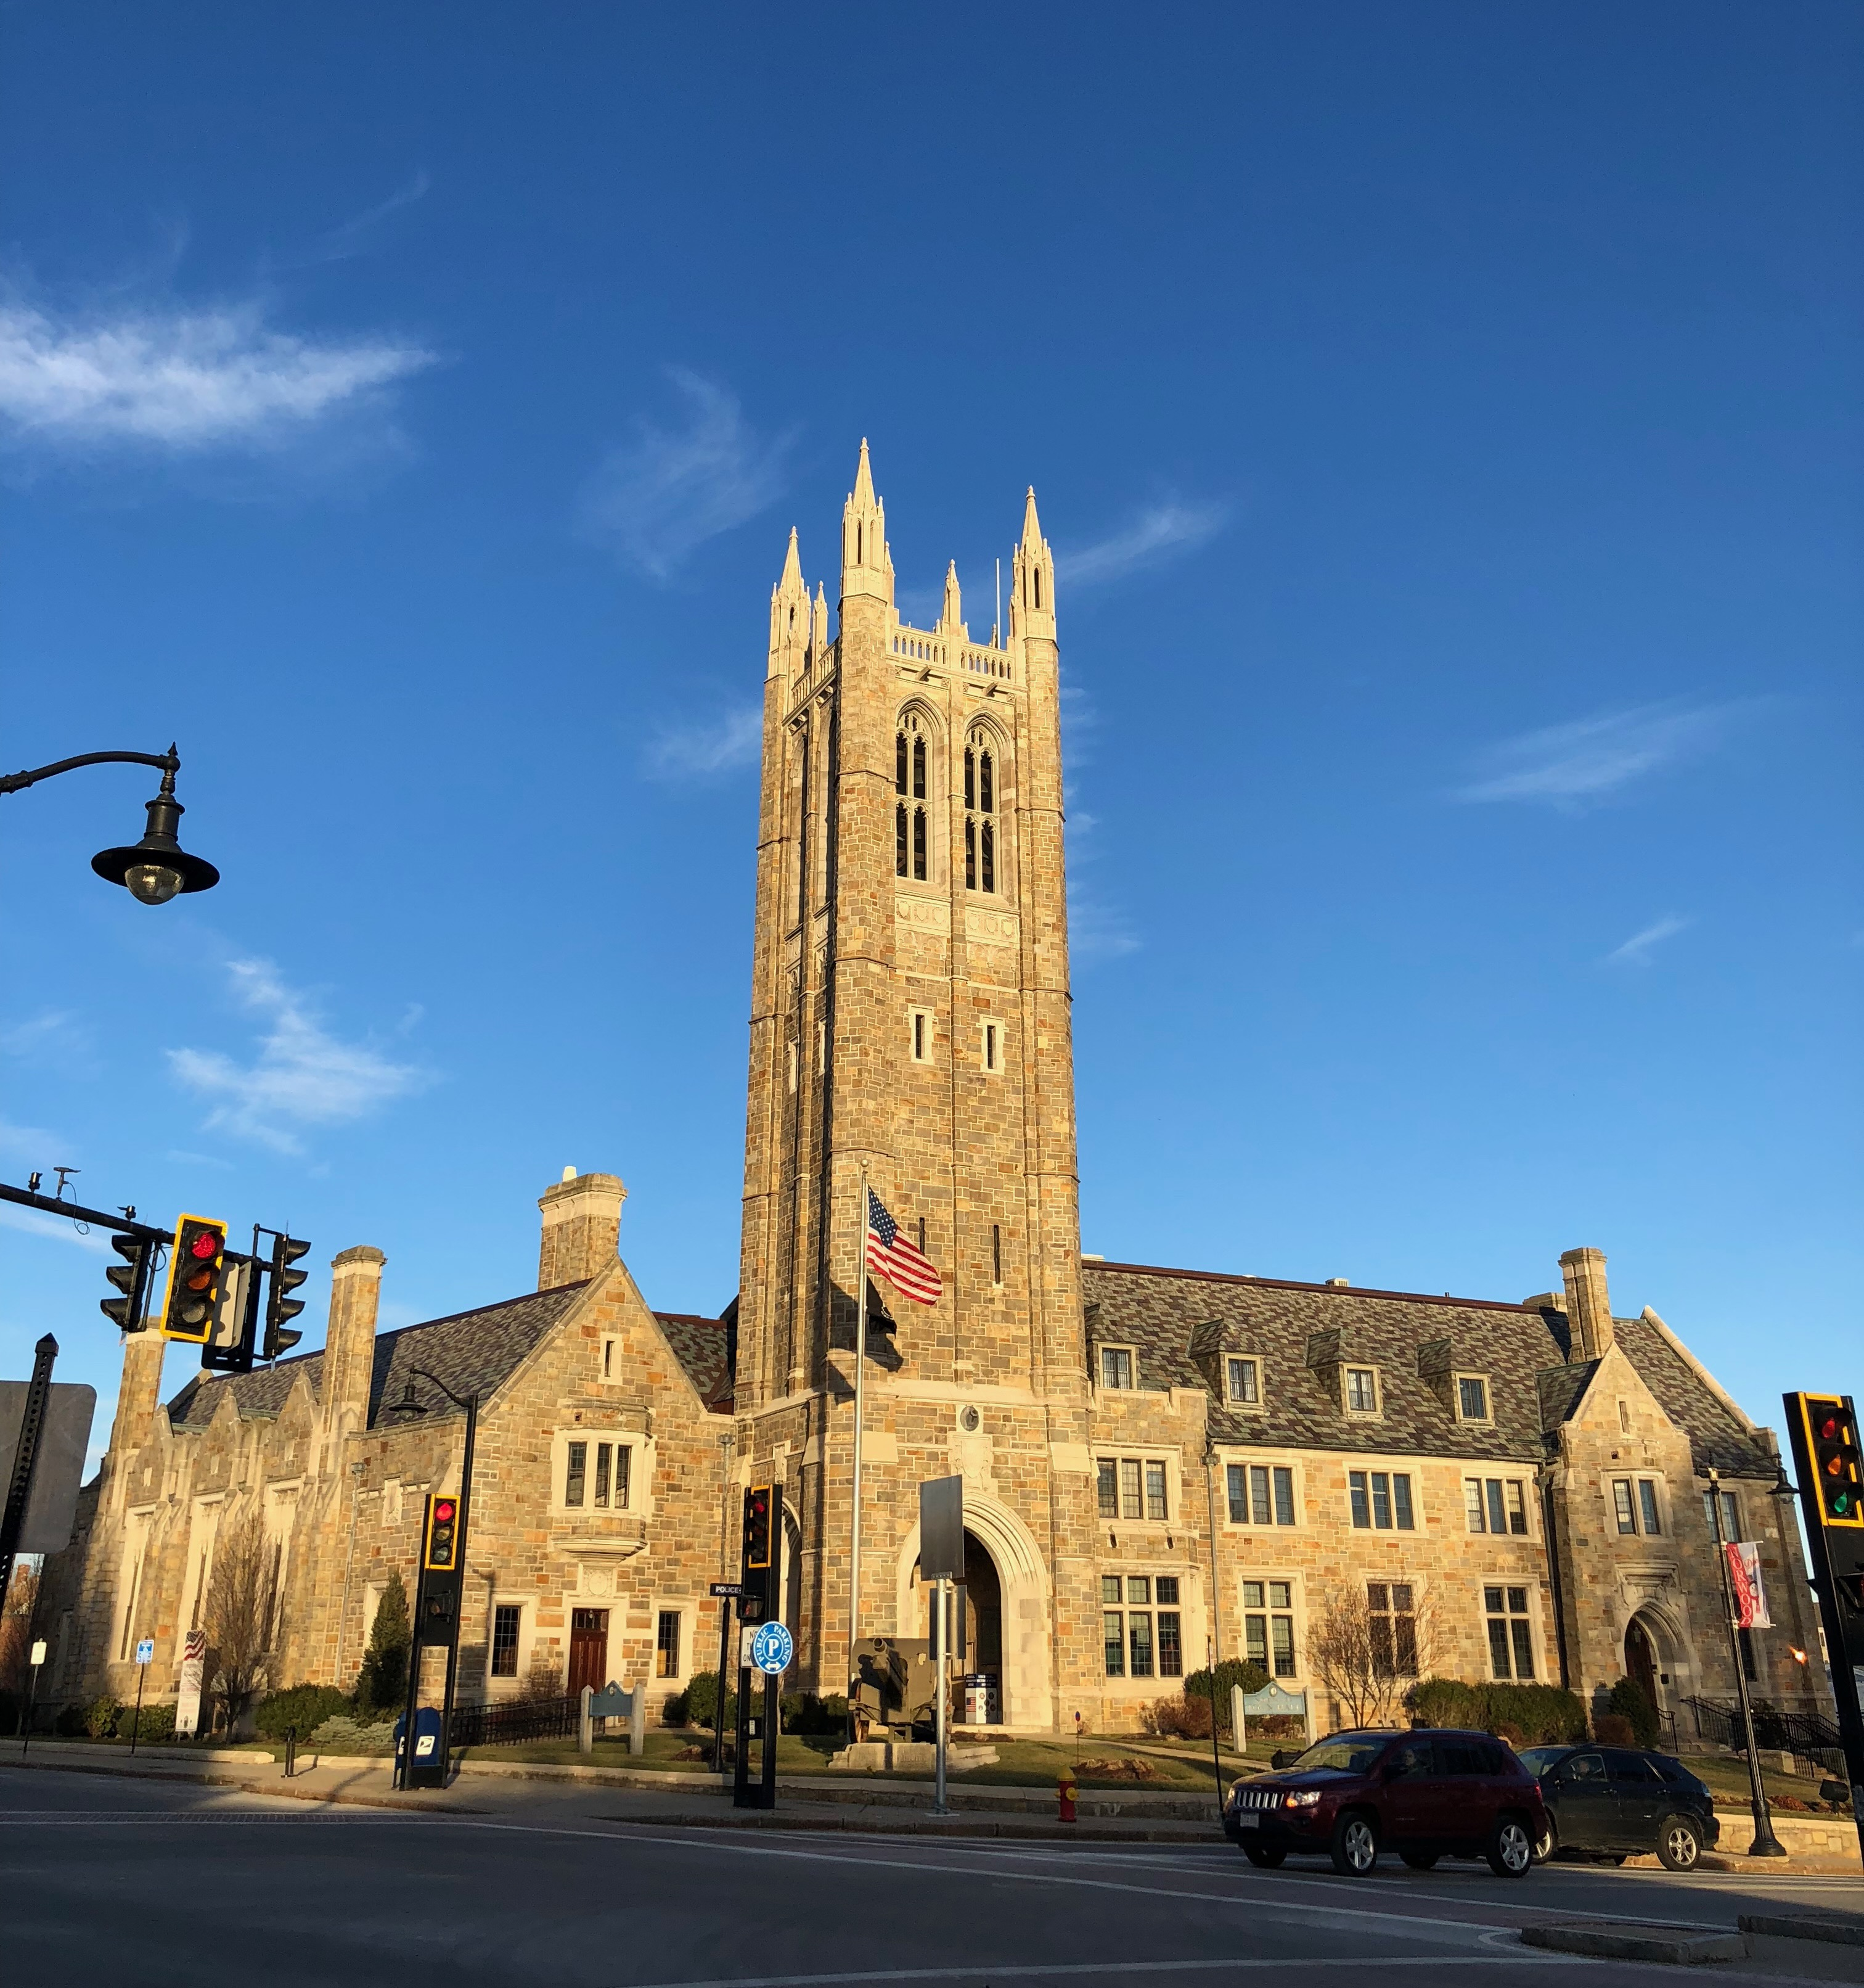
Walter F. Tilton (lot #302)
Walter Tilton was an important figure in the early decades of the 20th century in Norwood. He was a founding member of the board of directors of Norwood’s first bank, the Norwood National Bank and later was President of the Norwood Trust Company. He was also one of the founders of Norwood Hospital and one of that institution’s major benefactors. When the town’s municipal building was erected, Tilton donated the distinctive fifty-one bell carillon, housed in the Memorial Municipal Building’s soaring gothic tower. The first concert was held on 11 November1928 during the building’s dedication ceremonies. Tilton died in his Norwood home in 1950 at 93.

